Slide 1
XTDir for SobiPro
SobiPro and Akeeba Subscriptions Membership Management
Presentation based on Joomla 3, SobiPro 1.1 and XTDir 5.4
2014-07-22

Slide 2
XTDir for SobiPro
In this presentation, we are going to show how you can:
extend a SobiPro directory with XTDir,
manage subscriptions with Akeeba Subscriptions,
and promote entries with XTDir

Slide 3
XTDir for SobiPro - Akeeba Subscriptions
Prerequisites
XTDir v5.4, or superior
SobiPro v1.1, or superior
Akeeba Subscriptions v4.1, or superior
Joomla v2.5 / v3, or superior
MySQL 5.5 (recommended), or superior
PHP 5.3, or superior

Slide 4
XTDir for SobiPro - Installation
In this tutorial, we’ve assumed you have a working XTDir for SobiPro installation.
To review the installation steps, visit:
XTDir - How to extend your directory
XTDir - Building an advertising catalog for Joomla!

Slide 5
Akeeba Subscriptions - Creating Subscriptions to Sell
Akeeba Subscriptions is a subscriptions management component for Joomla! 2.x/3.x.
It's built using the Joomla! RAD Framework (FOF) and the best practices which ensure stability and security.

Slide 6
XTDir for SobiPro and Akeeba Subscriptions
How it works:
XTDir Promotions for SobiPro are assigned according to Joomla User Groups.
E.g. “Premium Subscribers”
Akeeba Subscriptions manages assigned User Groups according to the Level status.
In the following steps, we are showing how to:
Create a Joomla User Group
Create a Subscription, Payment Gateway, and customize a Joomla! Usergroup Integration
Create a XTDir User Group Promotion
Test a payment and verify an assigned membership

Slide 7
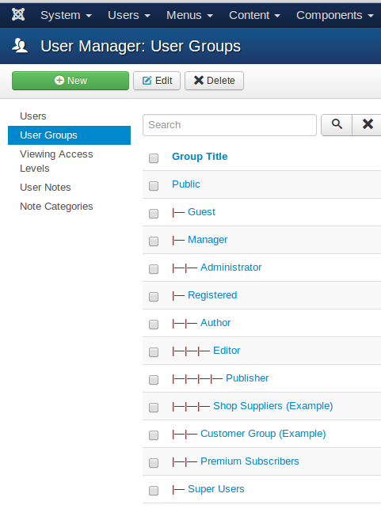
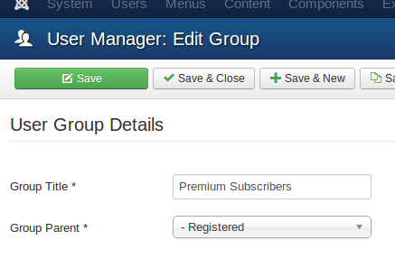
Step 1: Joomla! - Creating a User Group
Go to Website Backend > User Manager > User Groups > New.
Create a new user group “Premium Subscribers”.

Slide 8
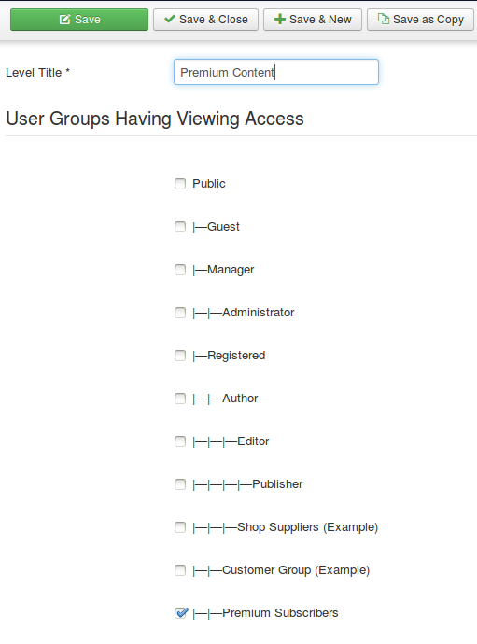
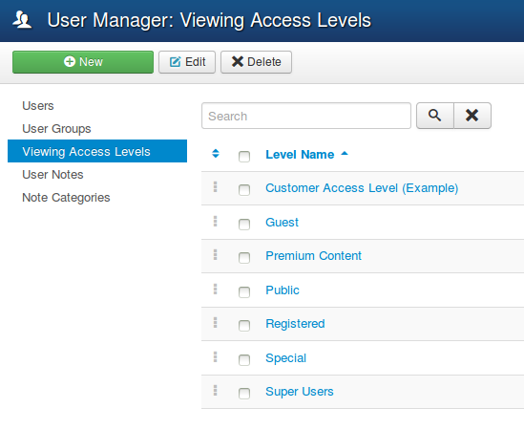
Step 1: Joomla! - Creating a Viewing Access Level
Go to Website Backend > User Manager > Viewing Access > New.
Create a new Viewing Access Level “Premium Content”.

Slide 9
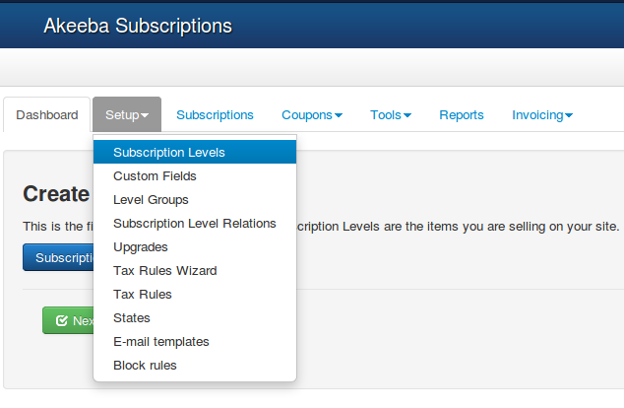
Step 2: Akeeba Subscriptions - Creating subscriptions
First, create subscriptions to sell membership.
Go to the Setup tab of Akeeba Subscriptions.
Follow the steps given for creating subscriptions.

Slide 10
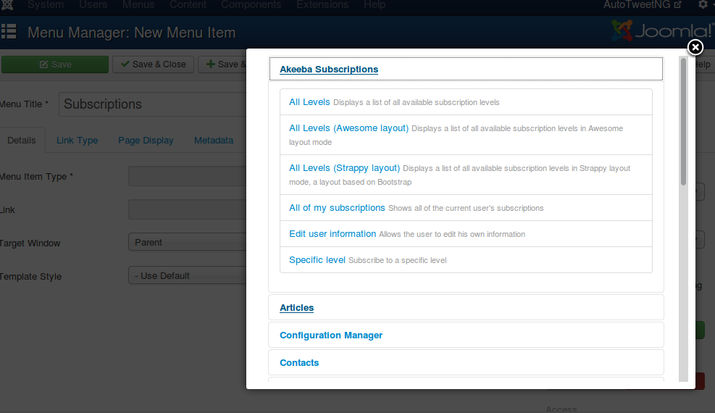
Step 2: Akeeba Subscriptions - Creating subscriptions
Create a menu to show subscriptions to customers

Slide 11
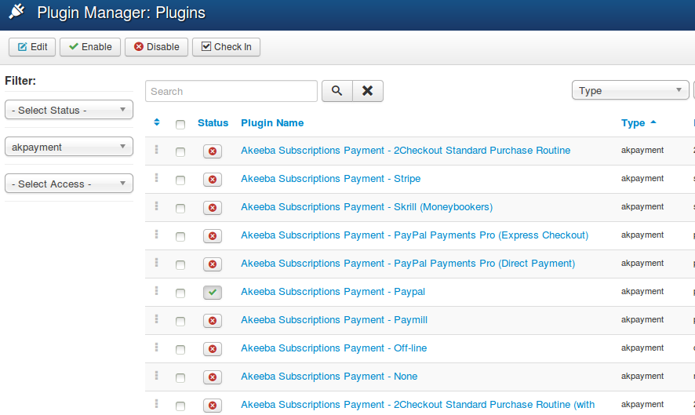
Step 3: Akeeba Subscriptions - Setting up a Payment Gateway
To process online payments automatically Payment gateway is required. Akeeba Subscriptions has integration with many popular payment gateways.
Go to Website Backend > Plugin Manager, search and enable required payment processor plugin.
Click on it to edit its configuration
Fill your account details of the payment processor.

Slide 12
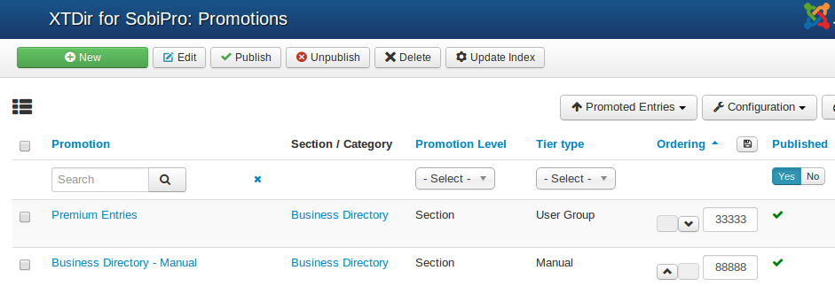
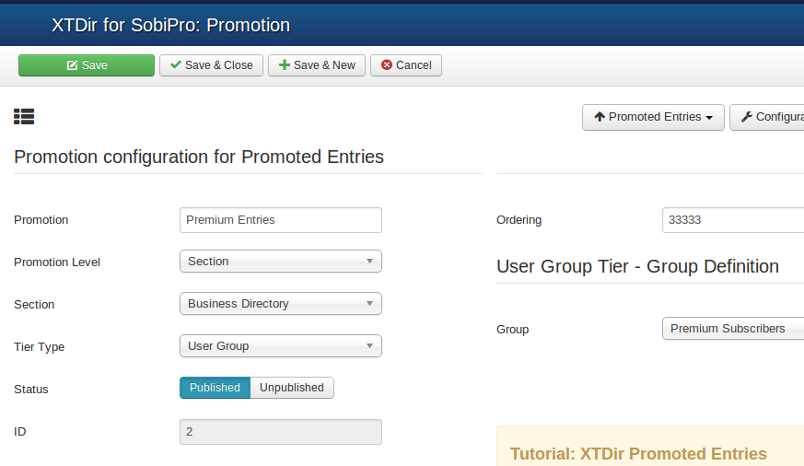
Step 4: XTDir - User Group Promotion
Go to Website Backend > XTDir > Promotions
Create a new Promotion
Fill Promotion details, and select “User Group” type, and the specific group.

Slide 13
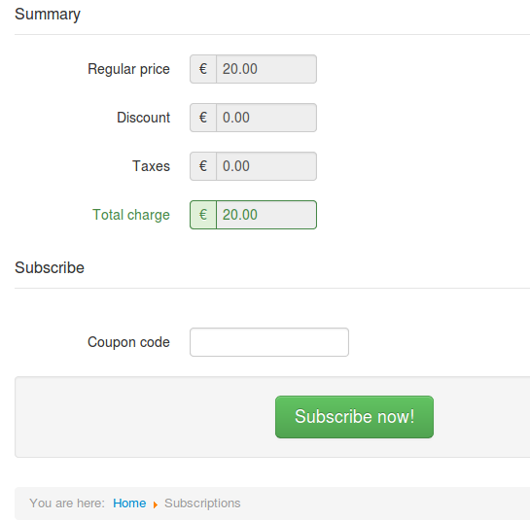
XTDir for SobiPro - Akeeba Subscriptions: A Membership Case
Fill a Subscription
Receive a Transaction
Verify Subscription Status
Verify User Group Assignment
Check Promotion Assignment
Browse the new featured entry

Slide 14
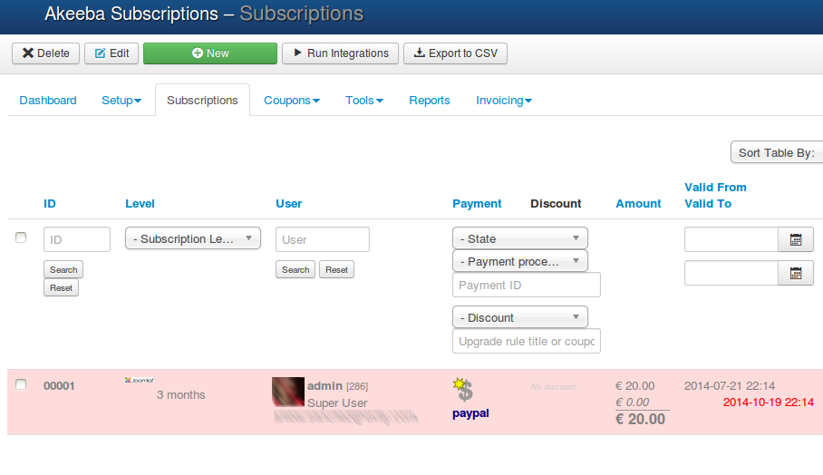
XTDir for SobiPro - Akeeba Subscriptions: A Membership Case
Fill a Subscription
Receive a Transaction
Verify Subscription Status
Verify User Group Assignment
Check Promotion Assignment
Browse the new featured entry

Slide 15
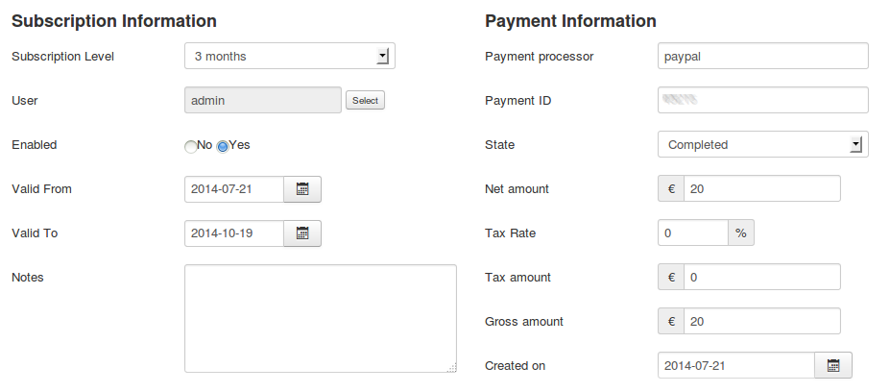
XTDir for SobiPro - Akeeba Subscriptions: A Membership Case
Fill a Subscription
Receive a Transaction
Verify Subscription Status
Verify User Group Assignment
Check Promotion Assignment
Browse the new featured entry

Slide 16
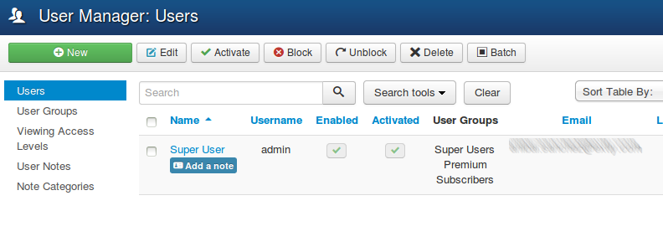
XTDir for SobiPro - Akeeba Subscriptions: A Membership Case
Fill an Invoice
Receive a Transaction
Verify Subscription Status
Verify User Group Assignment
Check Promotion Assignment
Browse the new featured entry

Slide 17
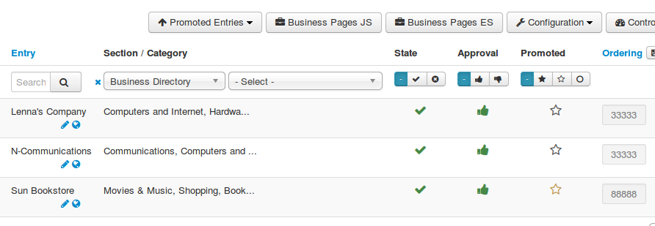
XTDir for SobiPro - Akeeba Subscriptions: A Membership Case
Fill an Invoice
Receive a Transaction
Verify Subscription Status
Verify User Group Assignment
Check Promotion Assignment
Browse the new featured entry
NOTE: Promotions are assigned after the indexing process is executed.

Slide 18
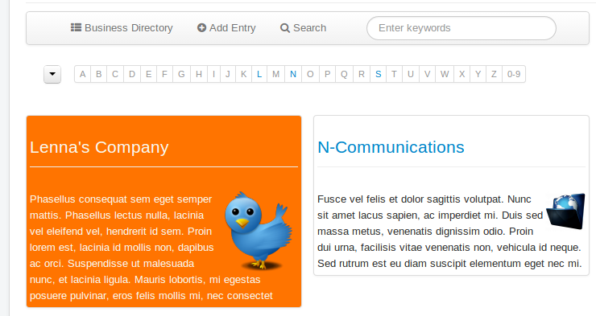
XTDir for SobiPro - Akeeba Subscriptions: A Membership Case
Fill an Invoice
Receive a Transaction
Verify Subscription Status
Verify User Group Assignment
Check Promotion Assignment
Browse the new featured entry
NOTE: Promoted Entries can be freely customized. Shown colors and layouts are for demo purposes only.

Slide 19
One last word
We love your feedback, it's our way to improve.
This presentation was created with your help.
Please post a rating and a review at the #JED
It really helps ;-)
Support: http://support.extly.com Community Forum Support: http://www.extly.com/forum/index.html
Twitter @extly
Facebook facebook.com/extly

