Slide 1
AutoTweetNG
How to AutoTweet from Your Own Facebook-Heroku App
Presentation based on Joomla 3 and AutoTweetNG 6.5.2
2013-09-18
http://www.extly.com/how-to-autotweet-from-your-own-facebook-heroku-app.html

Slide 2
How to AutoTweet from Your Own Facebook-Heroku App
In this presentation, we are going to show how you can AutoTweet from Joomla to Facebook, with Your Own Facebook-Heroku App
Product Page: http://www.extly.com/autotweet-ng-pro.html
Support: http://support.extly.com Community Forum Support: http://www.extly.com/forum/index.html

Slide 3
Prerequisites
AutoTweetNG Free or PRO v6.6, or superior
A Facebook account
System requirements:
- Joomla 2.5 / Joomla 3.0
- PHP 5.3, or superior
- MySQL 5.5, or superior (recommended)
Previous tutorials:
How to AutoTweet from Joomla in 5 minutes
How to AutoTweet from Your Own Facebook App
About SSL & Facebook

Slide 4
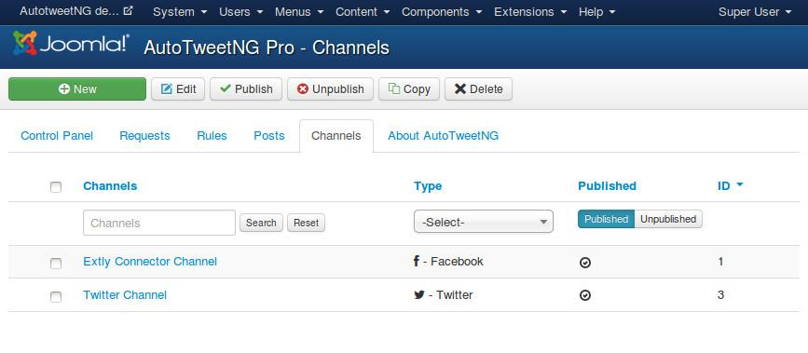
Add Facebook channel
Each Facebook Profile, Page or Group is a different channel.
Facebook Channels require the Facebook account authorization (a long-lived access token).
You can share the same token between Facebook channels.

Slide 5
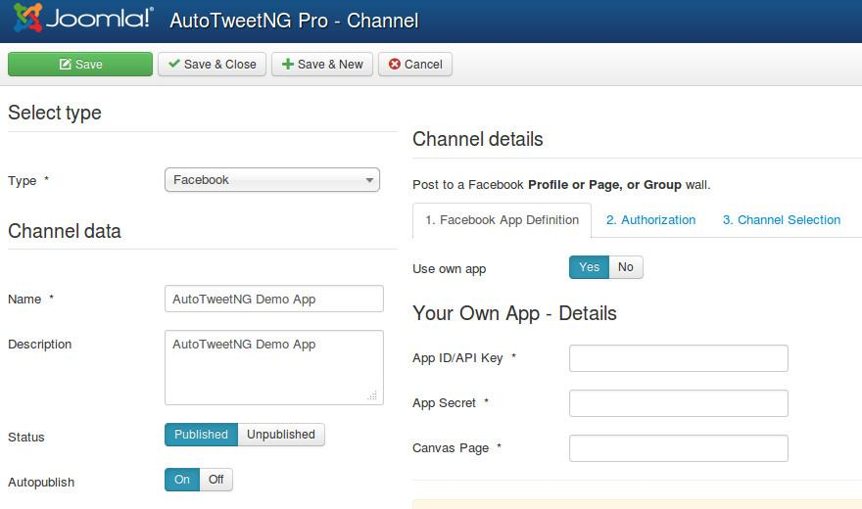
Add channel / Facebook
Assign channel type and data
Select User own app = Yes

Slide 6
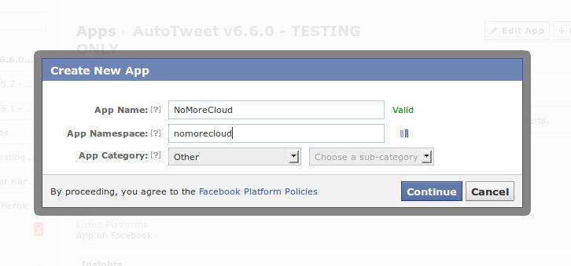
Create a Facebook-Heroku App
Login at https://developers.facebook.com/apps with your Facebook username and password
Create New App
Define the name & namespace

Slide 7
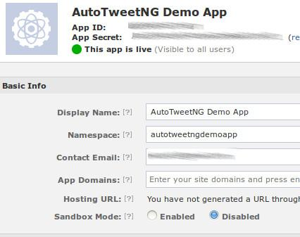
Create a Facebook-Heroku App
Now, you have your own:
App ID
App Secret
Don’t forget to disable sandbox mode.

Slide 8
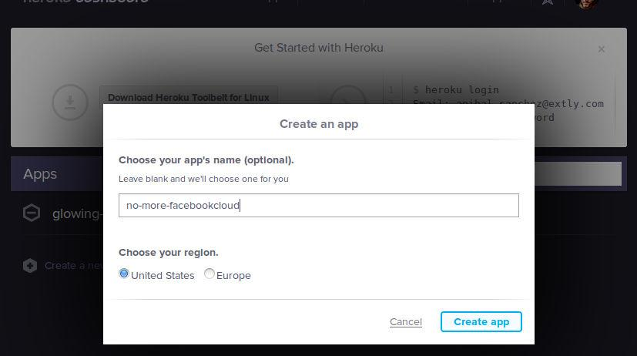
Create a Facebook-Heroku App
Access your Heroku account and create a new app hosting

Slide 9
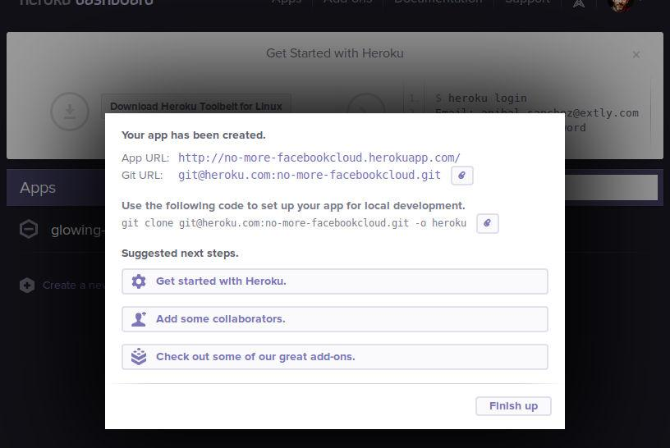
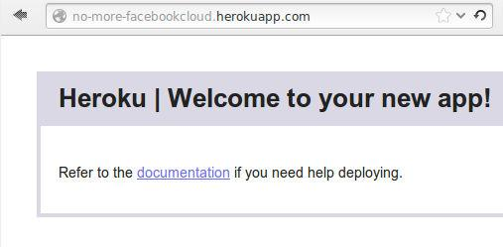
Create a Facebook-Heroku App
Access your Heroku account and create a new app hosting

Slide 10
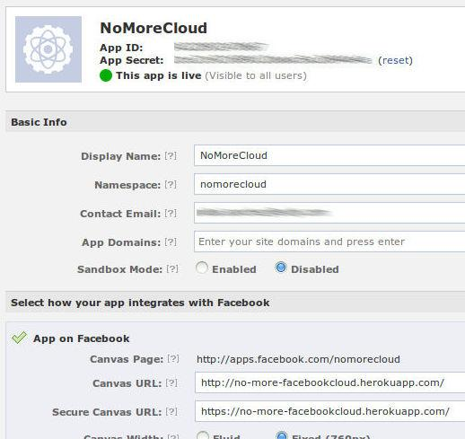
Create a Facebook-Heroku App
Back to Facebook App configuration, fill the Urls

Slide 11
Create a Facebook-Heroku App
Now, you have to upload Facebook-Heroku App files.
From AutoTweetNG downloaded zip file, extract the file: facebook_auth_app_v...zip
Upload the extracted files in your Heroku hosting, to create the Canvas Url and the Secure Canvas Url (see next slide for sample commands)
Manually, verify the Facebook App site
For example:
http://apps.facebook.com/nomorecloud
More info:
https://devcenter.heroku.com/articles/facebook

Slide 12
Create a Facebook-Heroku App
How to upload Facebook App files - Sample commands:
Download and install the Heroku toolbelt. Configure Your SSH Keys.
Fetch the default sample app:
git clone git@heroku.com:no-more-facebookcloud.git -o heroku
Delete all sample files, and copy AutoTweetNG App files
Push them to Heroku:
cd no-more-facebookcloud
git add *
git commit -am "AutoTweetNG App upload"
git push heroku master
Commands may change according your platform.

Slide 13
Create a Facebook-Heroku App
Verify the assigned Canvas Url and Secure Canvas Url in Facebook App Configuration, “App on Facebook” tab.
Save changes

Slide 14
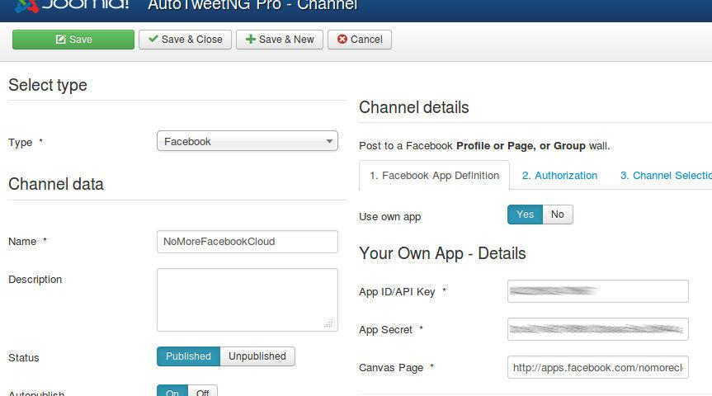
Add channel / Facebook
Back to the channel configuration
Fill the form: App Id, App Secret, and Canvas Page
Continue with steps: 2. Authorization and 3. Channel Selection
Previous tutorial: How to AutoTweet from Joomla in 5 minutes

Slide 15
Your Own Facebook-Heroku App
You've created Your Own Facebook-Heroku App, to post from AutoTweetNG.
You can freely customize it
Your posts are going to have your brand name
No need to configure SSL!
No need of SSL certificates!

Slide 16
One last word
We love your feedback, it's our way to improve.
This presentation was created with your help.
Please post a rating and a review at the #JED
It really helps ;-)
Support: http://support.extly.com Community Forum Support: http://www.extly.com/forum/index.html
Twitter @extly
Facebook facebook.com/extly

