Slide 1
AutoTweetNGRecipes
Improve your social streams with RSS Feeds
http://www.extly.com/autotweetng-recipe-improve-your-social-streams-with-rss-feeds.html
Presentation based on Joomla 3 and AutoTweetNG 6.7.0
2013-10-28

Slide 2
Recipe: Improve your social streams
AutoTweetNG allows automatic social publishing from Joomla to Facebook, Twitter, or LinkedIn.
In this presentation, we are going to show how you can increase and diversify your social stream content.
Product Page: http://www.extly.com/autotweet-ng-pro.html
Support: http://support.extly.com Community Forum Support: http://www.extly.com/forum/index.html

Slide 3
Prerequisites
AutoTweetNG Free, PRO or Joocial v6.7 or superior
Configured social channels
This tutorial assumes you have already done a basic configuration.
Previous Tutorial:How to AutoTweet from Joomla in 5 minutes

Slide 4
Leading Case: SM Running
The site owner “Ricardo” is the social media manager. He creates content in Joomla, and articles are automatically published to social channels: Facebook and Twitter.
He publishes weekly content of competitions and training. He can’t create content every day, and streams lag with no activity.
There are well-known running news sites, publishing articles every day.
AutoTweetNG now supports Feeds Automatic Posts for better streams management. Posts can be created based on trusted sources.
Url: http://www.sm-running.com/
Facebook: https://www.facebook.com/SMrunning - Twitter: https://twitter.com/SM_running

Slide 5
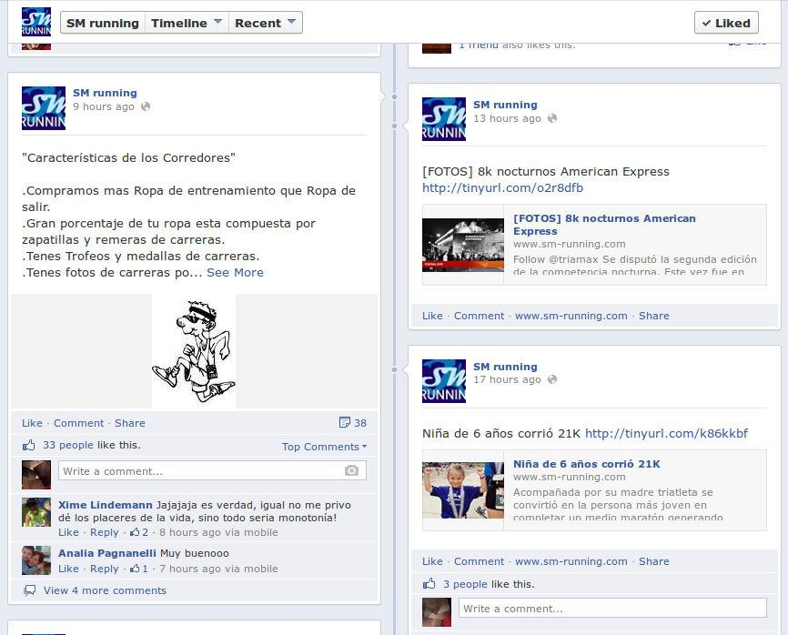
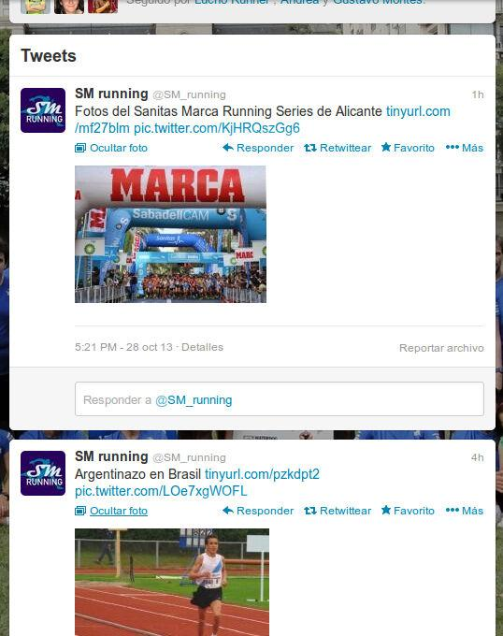
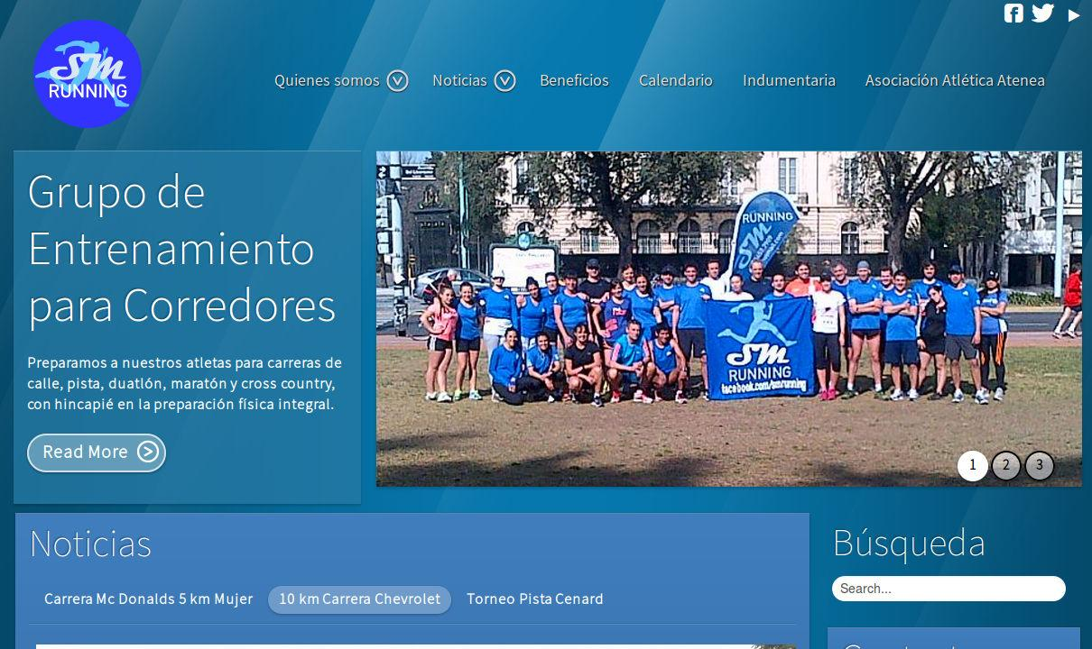
Leading Case: SM Running

Slide 6
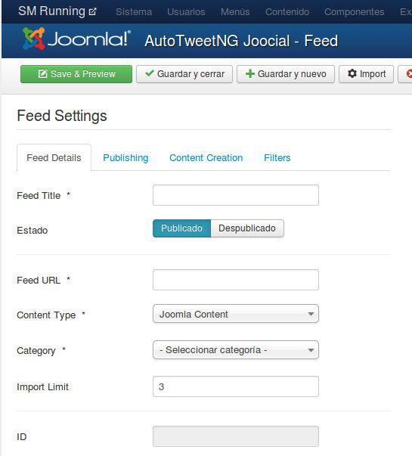
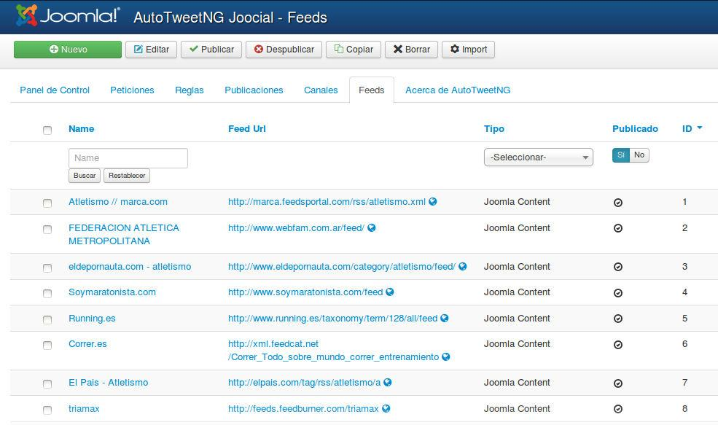
Step 1 - Create a new Feed
For example
Title:
Running.es
RSS: http://www.running.es/taxonomy/term/128/all/feed

Slide 7
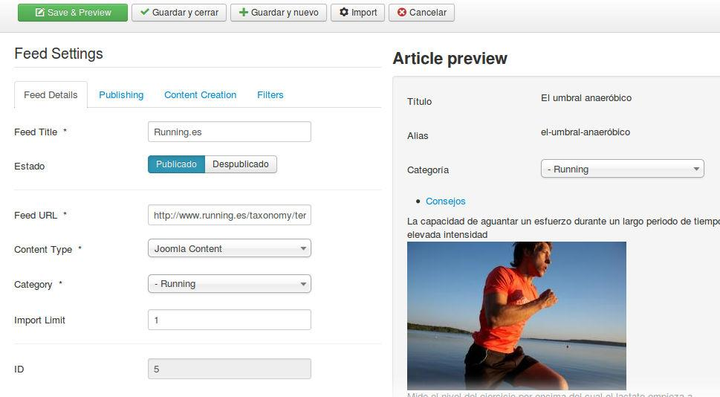
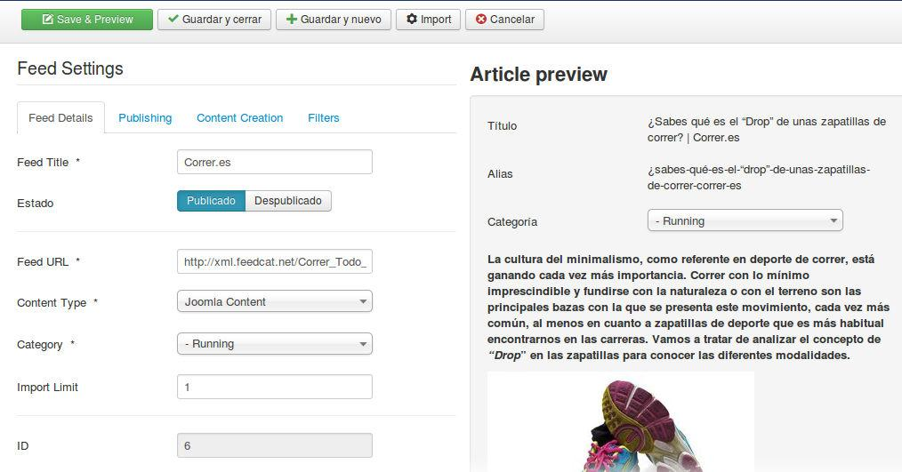
Step 2 - Save & Preview
In configuration tabs (Publishing, Content Creation, and Filters), the content can be adjusted.

Slide 8
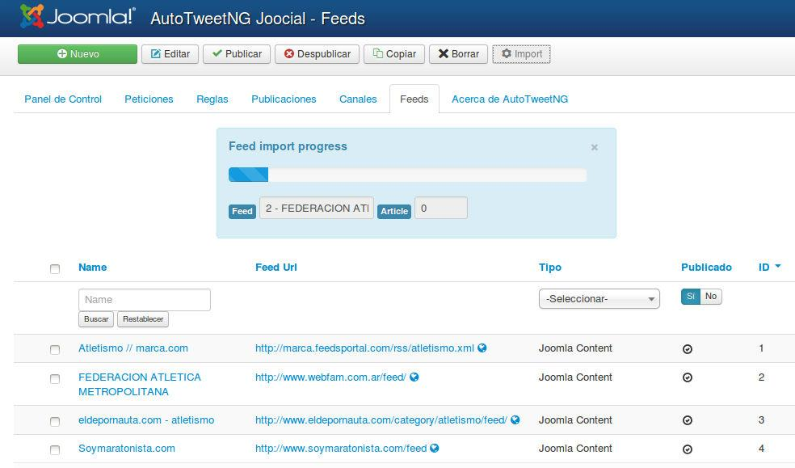
Step 3 - Import

Slide 9
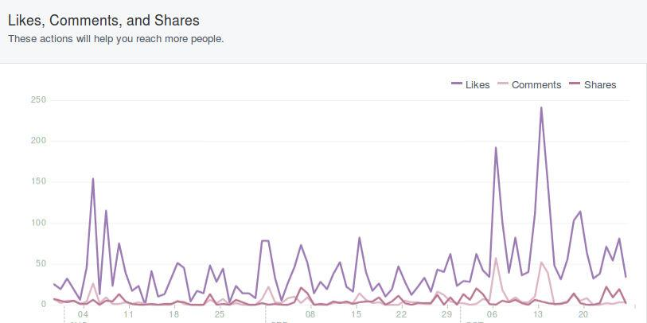
Step 4 - Social Media Strategy
Manual weekly content is published on Sundays
Import 1 article of each Feed per day
Number of Feeds: 7
Conclusion: Increased social activity, and better social content management.
Feeds launch

Slide 10
One last word
We love your feedback, it's our way to improve.
This presentation was created with your help.
Please post a rating and a review at the #JED
It really helps ;-)
Support: http://support.extly.com Community Forum Support: http://www.extly.com/forum/index.html
Twitter @extly
Facebook facebook.com/extly

