Slide 1
XTDir for SobiPro
How to extend your directory
Presentation based on Joomla 3, SobiPro 1.1 and XTDir 5
2013-10-28

Slide 2
XTDir for SobiPro
In this presentation, we are going to show how you can extend a SobiPro directory with XTDir solution.
The presentation includes how to install the full XTDir for SobiPro, and chapters for each associated modules and plug-ins.
Installation / Updates
Step 0 - Initial Core Index generation
Core Index for SobiPro Entries
Manual Index update
Cronjob update
On Page Load update
Entries Explorer
Promoted Entries,
Categories of SobiPro,
Extended Search Modules,
GeoMap Search,
Search In Categories Modules,
Search in Selected Sections
SobiPro Search Plugin+ (Plus), and
Smart Search Plugin

Slide 3
XTDir for SobiPro
In this presentation, we are going to show how you can extend a SobiPro directory with XTDir solution.
The presentation covers the full XTDir for SobiPro extension. Some features may be unavailable according your membership.
http://www.extly.com/guides-faq/75-extensions-for-sobipro-documentation/xtdir-for-sobipro.html
Product Page: http://www.extly.com/xtsobipro.html
Support: http://support.extly.com Community Forum Support: http://www.extly.com/forum/index.html

Slide 4
XTDir for SobiPro - Prerequisites
Prerequisites
XTDir 5.3, or superior
SobiPro 1.1, or superior (recommended)
SobiPro 1.0.8 is supported in compatibility mode
Joomla 2.5 /3, or superior
MySQL 5.5, or superior (recommended)
PHP 5.3, or superior

Slide 5
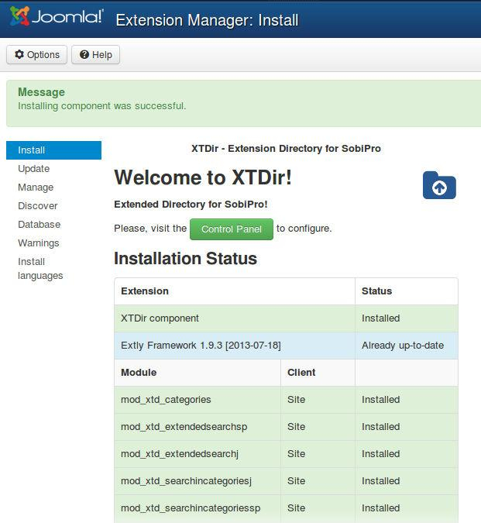
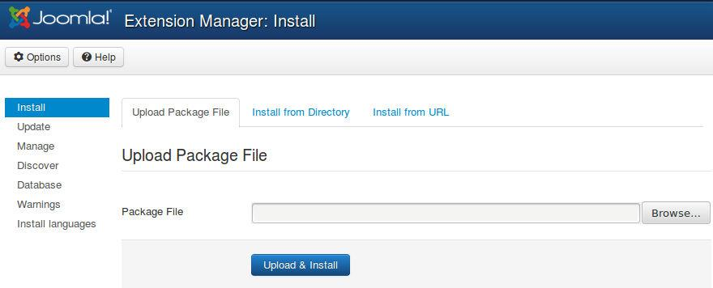
XTDir for SobiPro - Installation
1. Download and install XTDir for SobiPro

Slide 6
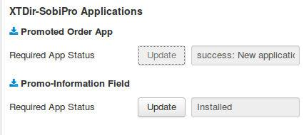
XTDir for SobiPro - Updates
1. XTDir updates are installed in the same way
2. Remember to also update SobiPro Apps with the Update button.
"Update" buttons in Promoted Entries/Configuration for Promoted Order App or Promo-Information Field
"Update" button in Configuration/Core Index for Router App

Slide 7
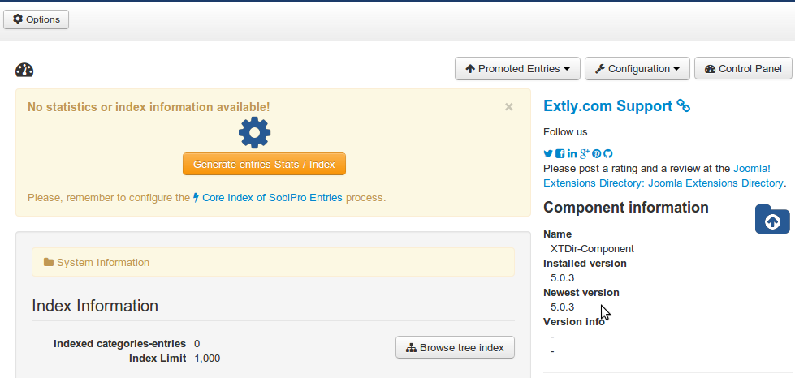
XTDir for SobiPro - Step 0
Control Panel - Core Index Generation
The Core Index is the information structure required to control:
Promoted Entries
Search Queries
Entries Explorer
Statistics
There are three ways to generate the Core Index:
Manually
Cronjob task (recommended) CLI or Web Script
On Page Load
To change it, please, check the following Core Index of SobiPro Entries chapter.

Slide 8
XTDir for SobiPro - Step 0
Manual Core Index Generation
You can just click in the button.
It's the default mode.
You choose when the index is generated
By default, restricted to 1000 entries.
TIP: Buttons for index updating can be found in management pages.
To process more entries, please, check the following Core Index of SobiPro Entries chapter.

Slide 9
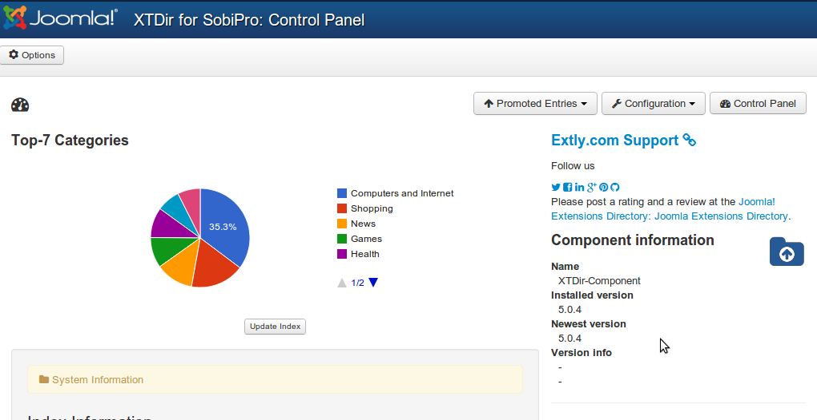
XTDir for SobiPro - Step 0
Manual Core Index Generation
The Core Index has been successfully generated!
You can check Statistics, Index information, Promoted Entries, and Cache Information in the Control Panel.
To process more entries, please, check the following Core Index of SobiPro Entries chapter.

Slide 10
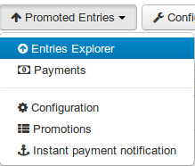
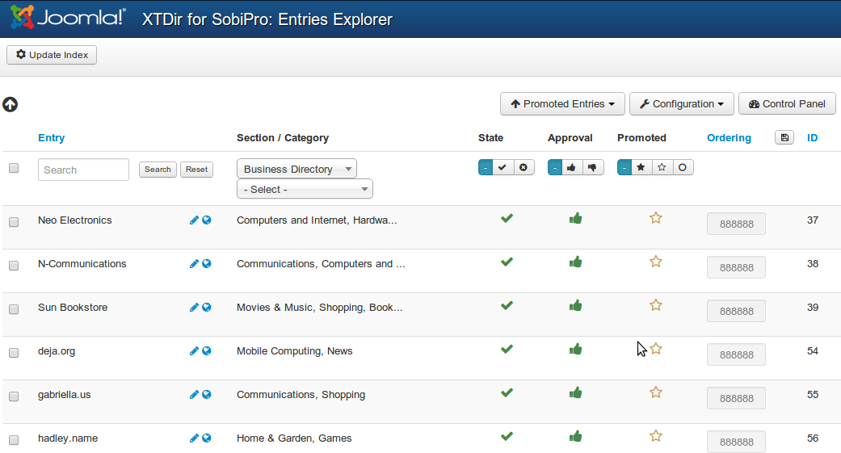
Entries Explorer
The Entries Explorer is the main tool to manage entries.
Navigational access to entries
Links to the SobiPro Entry Edition and Public Entry.
Section and Category filters
Entry State, Approval, and Promotion Status
Ordering management to control Promoted Entries

Slide 11
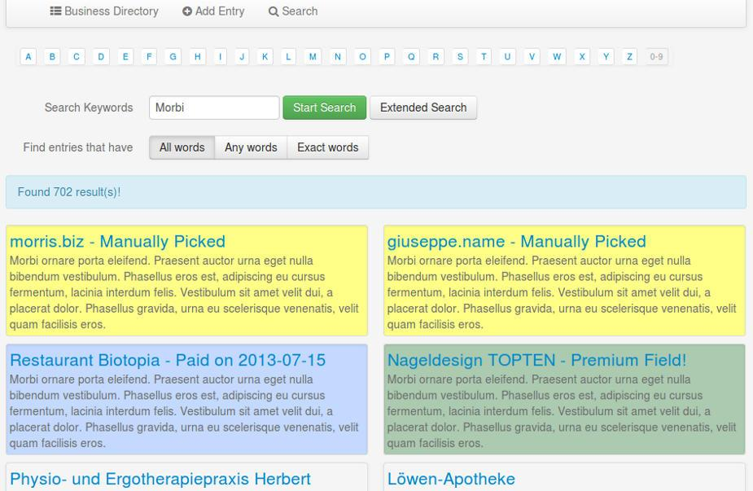
Promoted Entries - Cases
In SobiPro, there are 3 cases to promote entries:
Search Case: Results from a search query
Section / Category Navigation Case: Entries shown browsing a Section or a Category
Alpha Listing Case, visiting a Letter of the Alpha menu
XTDir allows to promote entries in each of these cases.

Slide 12
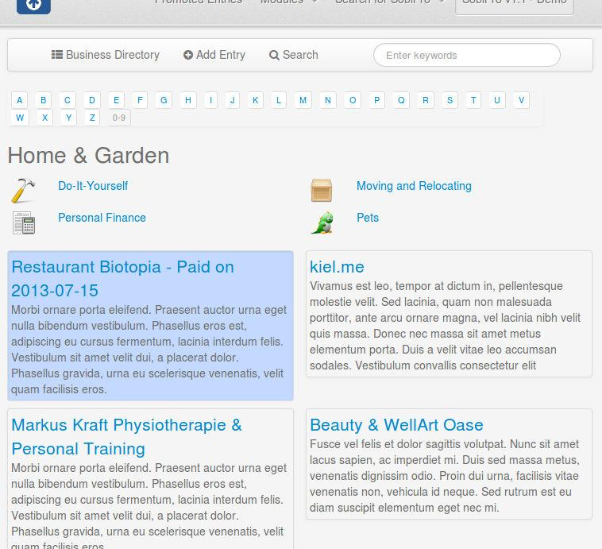
Promoted Entries - Cases
In SobiPro, there are 3 cases to promote entries:
Search Case: Results from a search query
Section / Category Navigation Case: Entries shown browsing a Section or a Category
Alpha Listing Case, visiting a Letter of the Alpha menu
XTDir allows to promote entries in each of these cases.

Slide 13
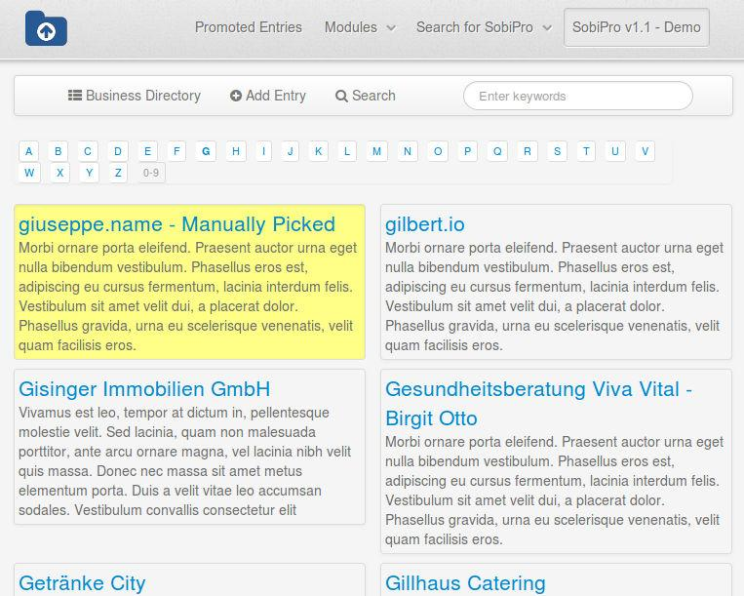
Promoted Entries - Cases
In SobiPro, there are 3 cases to promote entries:
Search Case: Results from a search query
Section / Category Navigation Case: Entries shown browsing a Section or a Category
Alpha Listing Case, visiting a Letter of the Alpha menu
XTDir allows to promote entries in each of these cases.

Slide 14
Promoted Entries - How it works
The Ordering defines the order of the entries shown and it's determined according Promotions.
Promotions can have a section or category scope; and there are three types of promotions:
Manual Promotion, you can define a default value for these entries. E.g. order number 888. You can also manually assign an ordering to specific entries. E.g Neo Electronics, order number 7.
Dynamic Promotion, the ordering is assigned to entries that have a specific value in a field. E.g. field_premium=option_premium.
Paid Promotion, integrated with SobiPro Paid Fields, you can configure Paypal Notifications (IPN) to receive the payment event and activate the entry with a specific ordering. E.g. Neo Electronics paid for a logo, order number 555; the entry is marked as paid promoted.
NEW User Group Promotions: Check the new tutorial: XTDir - SobiPro and PayPlans Membership Management

Slide 15
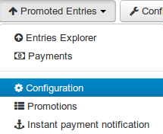
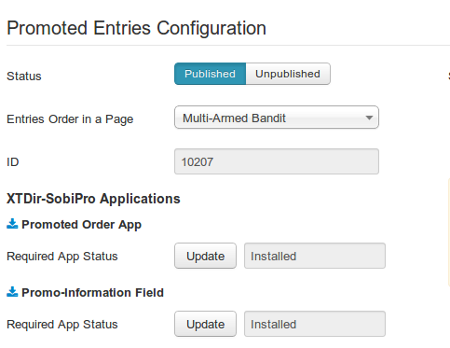
How it works - Promoted Order App
How it works: You configure Promotions, or manually assign an ordering to each entry. When the Core Index is generated by the XTDir component, each entry ordering is calculated and assigned (by default, each entry is assigned with ordering 888888). The Promoted Order App is installed and activated in each SobiPro section. It works on events associated with Search, Categories Navigation, and Alpha Listing to change the results default order according to the Promotions definition. Also, the SobiPro Entries Position is updated according the Promotions definitions.
Multi-armed bandit Algorithm: Promoted entries can be sorted by Multi-armed bandit (Top 10% Random, 90% ordered by Hits). The rest of entries are shown in random order. The same algorithm used by Google Adwords.

Slide 16
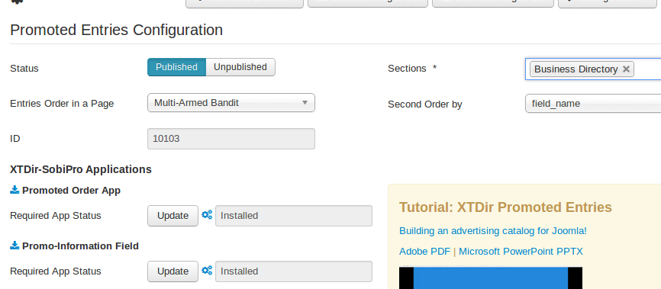
How it works - Promoted Order App
How it works: each promotion define an ordering "main order" for entry position. You can also define a Second Order by, in "Promoted Entries Configuration", to add a "sub-order" the entry position. E.g. name

Slide 17
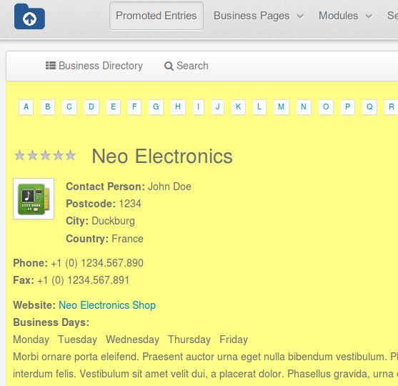
How it works - Promo-Information Field
Promo-Information Field, it provides a new read-only field to customize the entry visualization.
For example, in the entry/details.xsl a class can be added to customize the visual output according the promotype_id (sEction or Category), tiertype_id (Manual, Dynamic, Paid), and ordering:
<xsl:attribute name="class">
SPDetails
promoted_<xsl:value-of select="entry/fields/field_promoinformation/data/promotype_id" />
promoted_<xsl:value-of select="entry/fields/field_promoinformation/data/tiertype_id" />
promoted_<xsl:value-of select="entry/fields/field_promoinformation/data/ordering"/>
</xsl:attribute>
The field also provides access to other information like: ordering, hits counter, promoentry_id (assigned manual entry Id), and promoorder_id (paid order number). E.g. promoted_E promoted_M promoted_88888. To add a CSS background color: #SobiPro .promoted_88888 { background-color: #FFFF88; }

Slide 18
Manual Promotions
Promotions can have a section or category scope.
Default Promotion, each entry has assigned the order number 888888.
Manual Promotion: You can manually change the ordering to specific entries. E.g morris.biz, order number 1 (check next slide).
More about Promotions, step-by-step cases:
XTDir Promoted Entries - Building an advertising catalog for Joomla!
http://www.extly.com/xtdir-building-an-advertising-catalog-for-joomla.html

Slide 19
Dynamic Promotions
Promotions can have a section or category scope.
Dynamic Promotion, the ordering is assigned to entries that have a specific value in a field. E.g. field_premium= option_premium
More about Promotions, step-by-step cases:
XTDir Promoted Entries - Building an advertising catalog for Joomla!
http://www.extly.com/xtdir-building-an-advertising-catalog-for-joomla.html

Slide 20
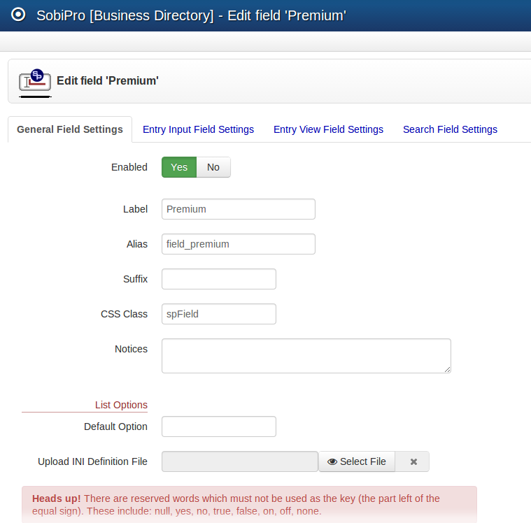
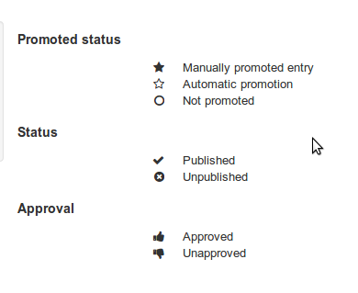
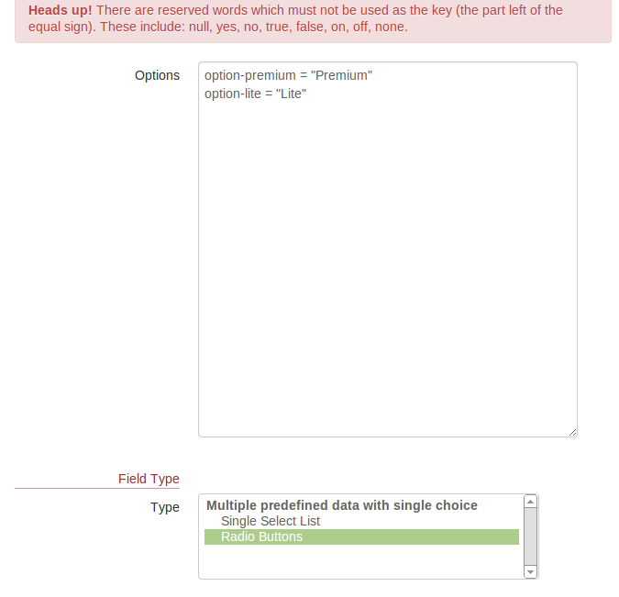
Dynamic Promotions
Promotions can have a section or category scope.
Dynamic Promotion, the ordering is assigned to entries that have a specific value in a field. E.g. a radio field field_premium with values option-premium or option-lite.
More about Promotions, step-by-step cases:
XTDir Promoted Entries - Building an advertising catalog for Joomla!
http://www.extly.com/xtdir-building-an-advertising-catalog-for-joomla.html

Slide 21
Paid Promotions
SobiPro does already support paid fields:
After a user creates an entry, SobiPro redirects to Paypal for payment.
The missing link: “SobiPro does not receive the payment confirmation and change the entry status.”
XTDir provides this feature, based on Paypal Instant Payment Notitication.
To configure IPN, please, check the following Promoted Entries IPN Entries chapter.

Slide 22
Paid Promotions
Promotions can have a section or category scope.
Paid Promotion, integrated with SobiPro Paid Fields,
You can configure Paypal Notifications (IPN) to receive the payment event and activate the entry with a specific ordering. E.g. Restaurant Biotopia paid for a logo, order number 555; the entry is marked as paid promoted.
More about Promotions, step-by-step cases:
XTDir Promoted Entries - Building an advertising catalog for Joomla!
http://www.extly.com/xtdir-building-an-advertising-catalog-for-joomla.html
To configure IPN, please, check the following Promoted Entries IPN Entries chapter.
SobiPro TIP: How to charge for the whole entry

Slide 23
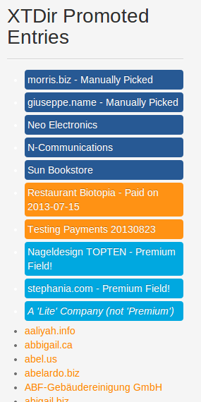
Widgets For Entries
Entries are mostly browsed in SobiPro component context. However, to feature promoted entries, XTDir provides several “widget” modules for entries:
Promoted Entries module
Accordion Entries module (Bootstrap Vertical and Horizontal Layout)
Grid of Entries module
Based on: Sigsiu’s Entries Module for SobiPro.

Slide 24
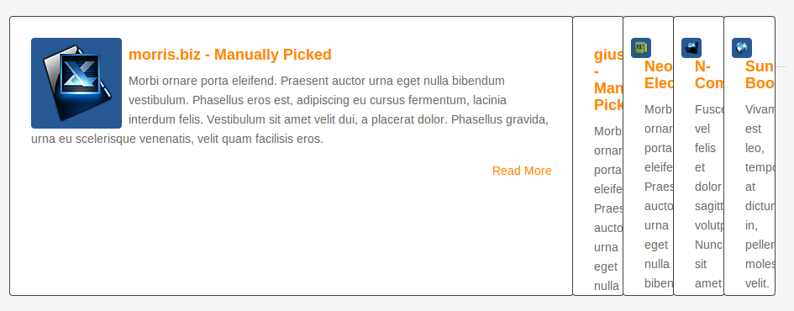
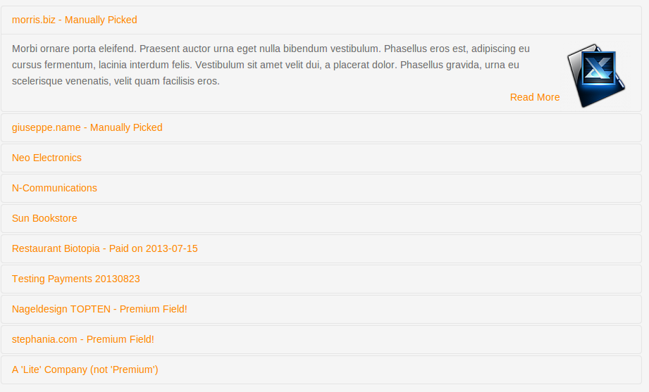
Widgets For Entries
Entries are mostly browsed in SobiPro component context. However, to feature promoted entries, XTDir provides several “widget” modules for entries:
Promoted Entries module
Accordion Entries module (Bootstrap Vertical and Horizontal Layout)
Grid of Entries module
Based on: Sigsiu’s Entries Module for SobiPro.

Slide 25
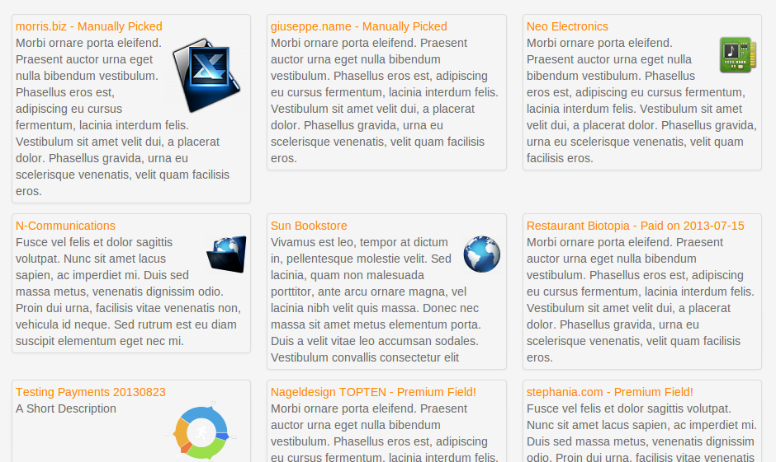
Widgets For Entries
Entries are mostly browsed in SobiPro component context. However, to feature promoted entries, XTDir provides several “widget” modules for entries:
Promoted Entries module
Accordion Entries module (Bootstrap Vertical and Horizontal Layout)
Grid of Entries module
Based on: Sigsiu’s Entries Module for SobiPro.

Slide 26
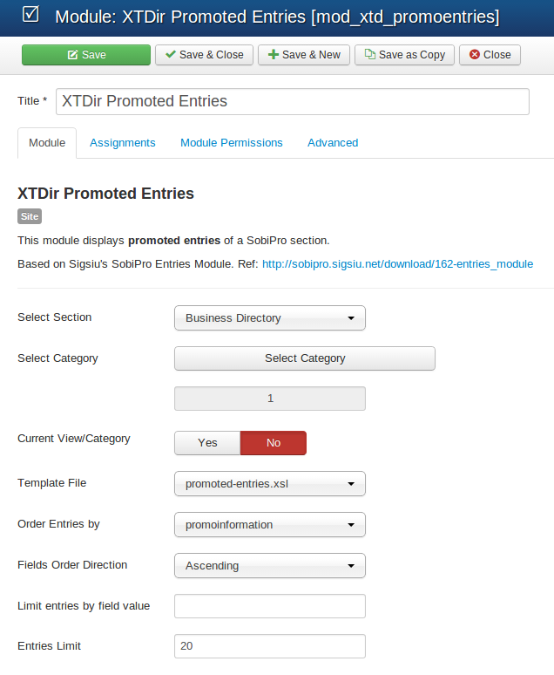
Widgets For Entries - Config
Widgets modules share a similar configuration.
Select section
Select module templateIt can be any of the packaged templates, or you can create your own (directory components/com_sobipro/usr/templates/front/modules). Templates follow SobiPro XSLT practices.
Select order field You can select the PromoInformation field.

Slide 27
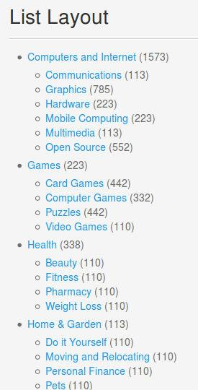
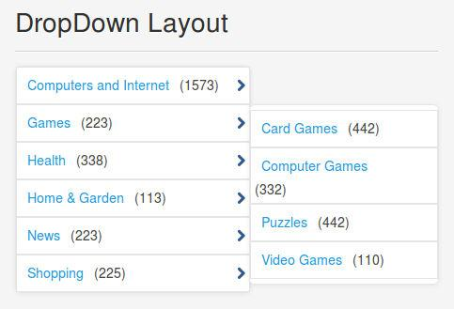
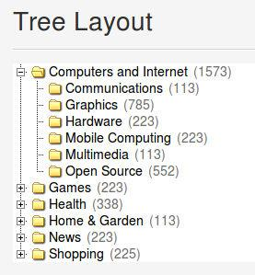
Categories of SobiPro Module
XTDir Categories of SobiPro is a module to show a list of categories in your site.
Supports 6 Layouts:
Category List,
Chained Selects,
Drop Down Menu,
SobiPro 1.1 Single Select,
Top Ranking, and
Tree of Categories

Slide 28
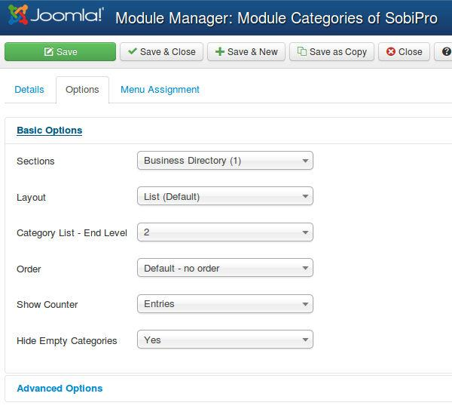
Categories of SobiPro Module
Select the Section
Select the Layout
Select the exact number of levels - more levels than available is not allowed -
Select the order of categories
Select to show the Counter of Hists or Entries
Select to Hide the Empty Categories
NOTE: The Entries Counter requires to have the Core Index updated to show the Stats.

Slide 29
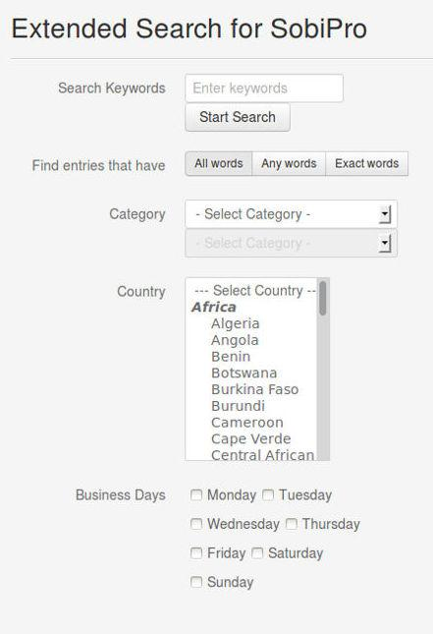
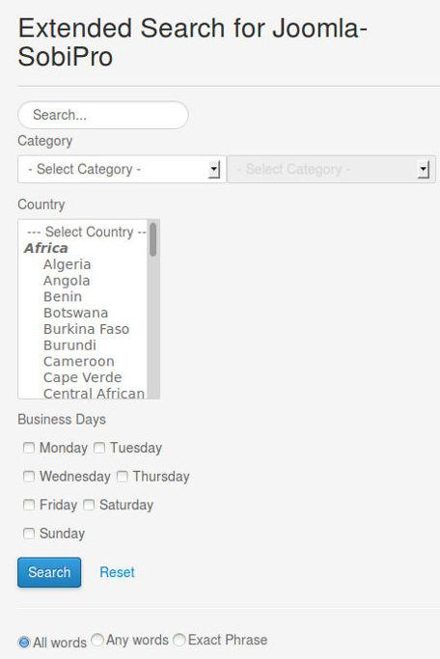
Extended Search Modules
XTDir Extended Search Module is a module that provides a way to show the SobiPro Extended Search form with Search Box and a set of Search Fields, in a module.
Two modules are available:
Extended Search Module for SobiPro, submits the query to SobiPro.
Extended Search Module for Joomla-SobiPro, submits the query to Joomla general search, requires our Search Plugin to be activated.

Slide 30
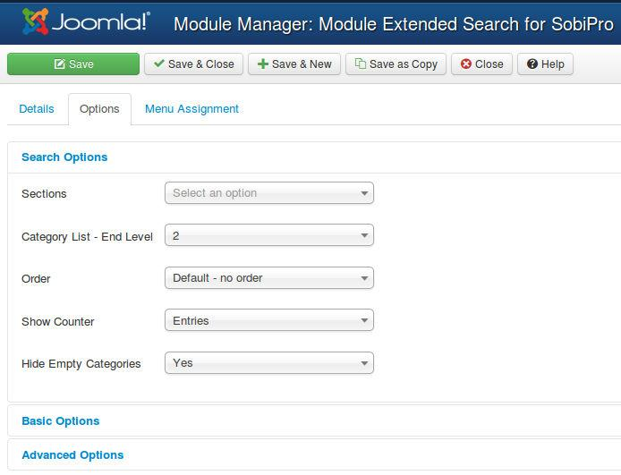
Extended Search Modules
Both modules have similar configuration options.
First, select how the Category selection is shown. It can be default SobiPro selection, or the customized chained select, with entries counter.

Slide 31
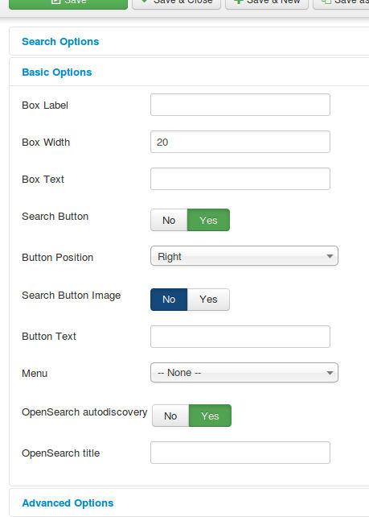
Extended Search Modules
Both modules have similar configuration options.
First, select how the Category selection is shown. It can be default SobiPro selection, or the customized chained select, with entries counter.
Several style parameters are available in the basic configuration.

Slide 32
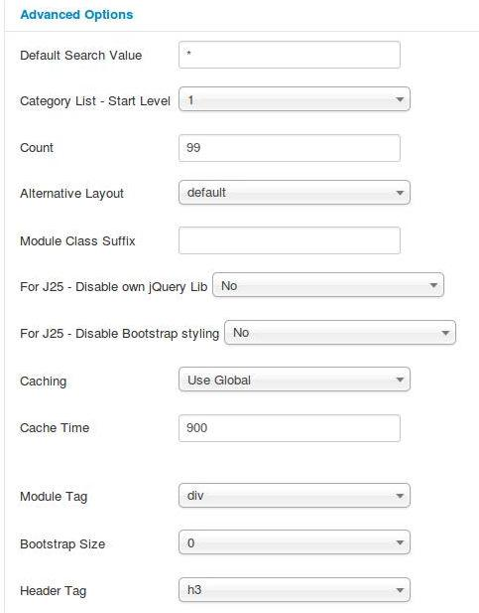
Extended Search Modules
Both modules have similar configuration options.
First, select how the Category selection is shown. It can be default SobiPro selection, or the customized chained select, with entries counter.
Several style parameters are available in the basic configuration.
In the advanced configuration:
You can define a default search value. By default, it submits the value to return all matching entries
You can also restrict how categories are shown.
NOTE for Joomla 2.5: You can disable our jQuery library instance (E.g. in SobiPro pages, to avoid two conflicting libraries), or the Bootstrap styling.

Slide 33
Extended Search Modules
About Empty Search and Default Search Value, found in several of our extensions:
It refers to the search when user does not enter any text and just clicks on search button.
By default, SobiPro returns 0 entries when no text is entered.
If you define * as the default value for Empty Search, SobiPro returns all entries.
If you define a custom string, it return the associated results.

Slide 34
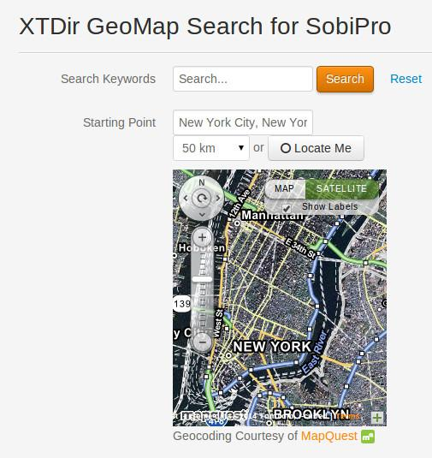
GeoMap Search Module
The module shows a search form specific for SP GeoMap field, or XTDir GeoMap field for Promoted Entries.
Proximity Search, which lets the visitors search entries within the proximity of a given location
Compatible with XTDir Promoted Entries
Compatible with SP GeoMap field
XTDir GeoMap field for Promoted Entries allows to show search results ordered by priority and distance

Slide 35
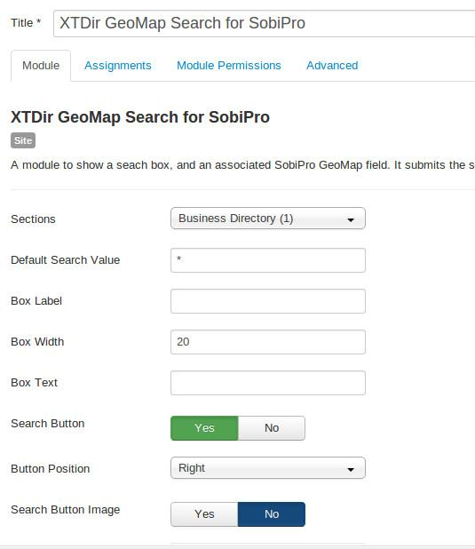
GeoMap Search Module
To enable the module, the section has to be selected and the position to show the module.
Also, a default search value can be defined.
To show Promoted GeoMap search results, install and configure XTDir PromoGeoMap field.

Slide 36
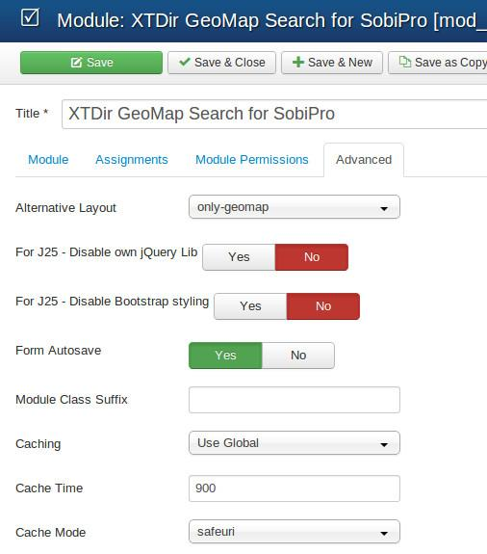
GeoMap Search Module
Several alternative layouts are available. To show only the geomap search, the “only-geomap” layout is provided.
To show Promoted GeoMap search results, install and configure XTDir PromoGeoMap field.

Slide 37
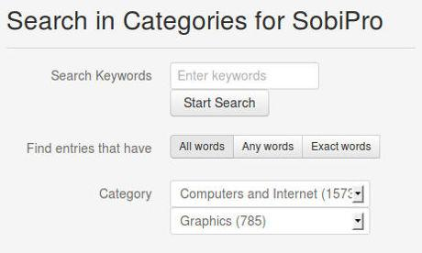
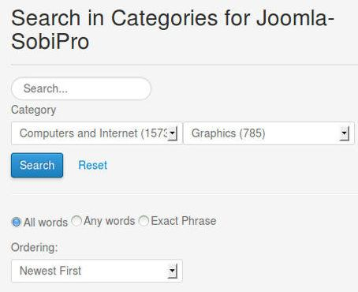
Search In Categories Modules
XTDir Search in Categories is a module to show a Search Box associated with a list of categories, to search into a selected category.
Two modules are available:
Search in Categories Module for SobiPro, submits the query to SobiPro.
Search in Categories Module for Joomla-SobiPro, submits the query to Joomla general search, requires our Search Plugin to be activated.

Slide 38
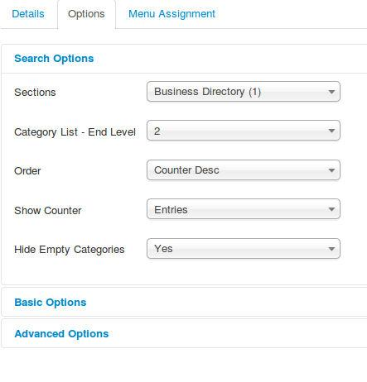
Search In Categories Modules
Both modules have similar configuration options.
First, select how the Category selection is shown. It can be default SobiPro selection, or the customized chained select, with entries counter.

Slide 39
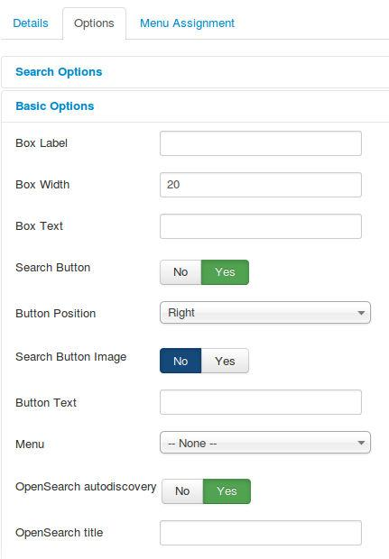
Search In Categories Modules
Both modules have similar configuration options.
First, select how the Category selection is shown. It can be default SobiPro selection, or the customized chained select, with entries counter.
Several style parameters are available in the basic configuration.

Slide 40
Search In Categories Modules
Both modules have similar configuration options.
First, select how the Category selection is shown. It can be default SobiPro selection, or the customized chained select, with entries counter.
Several style parameters are available in the basic configuration.
In the advanced configuration:
You can define a default search value. By default, it submits the value to return all matching entries
You can also restrict how categories are shown.
NOTE for Joomla 2.5: You can disable our jQuery library instance (E.g. in SobiPro pages, to avoid two conflicting libraries), or the Bootstrap styling.

Slide 41
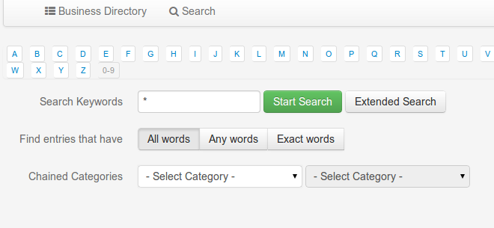
Chained Categories Control for Search
XTDir Chained Categories Control for Search provides support for:
Empty keyword search: searching with the * keyword to match all entries, entries filtered by a category, or a combination of filters.
Chained categories control: to show several levels of category chained selects.

Slide 42
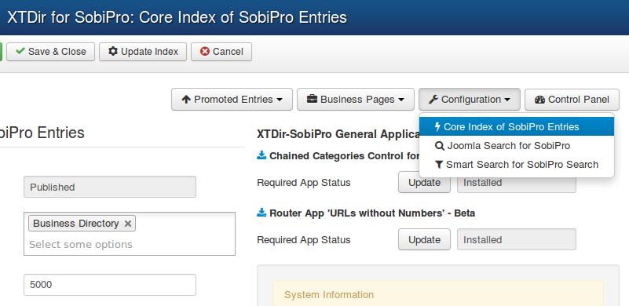
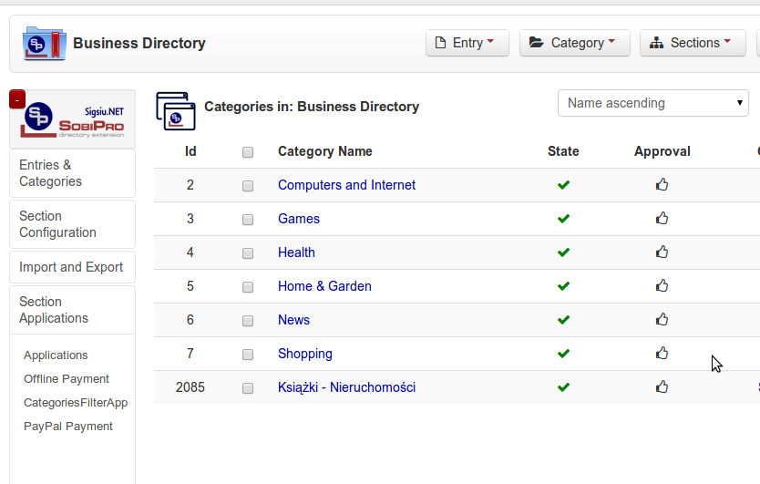
Chained Categories Control for Search
Install the App from XTDir component
Enable App in each section.
App configuration have to be done in each SobiPro Section
Configure App in SobiPro Section

Slide 43
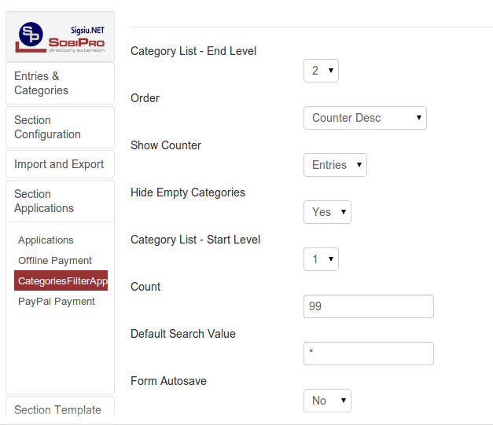
Chained Categories Control for Search
Several parameters are available in the basic configuration.

Slide 44
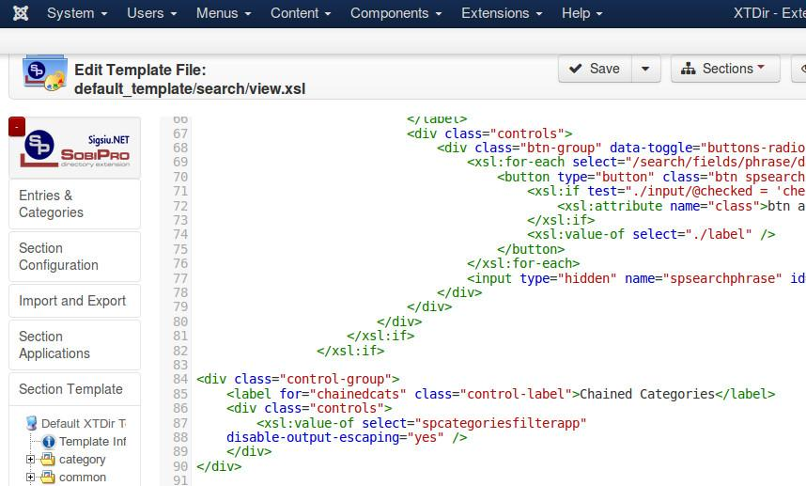
Chained Categories Control for Search
Finally, insert the app render code into each section template, search view.
<xsl:value-of select="spcategoriesfilterapp" disable-output-escaping="yes" />
Example: http://demo.xtdir.com/sobipro/sobipro-search-with-chained-categories.html

Slide 45
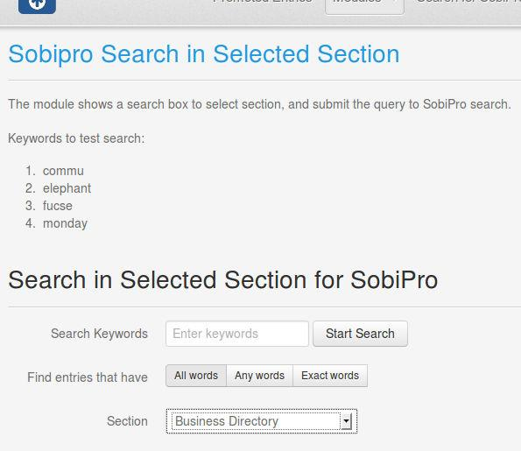
Search In Selected Section
The module shows a Search box with a Selection of Sections to search into.
If there's only one section configured, no section choice is shown.

Slide 46
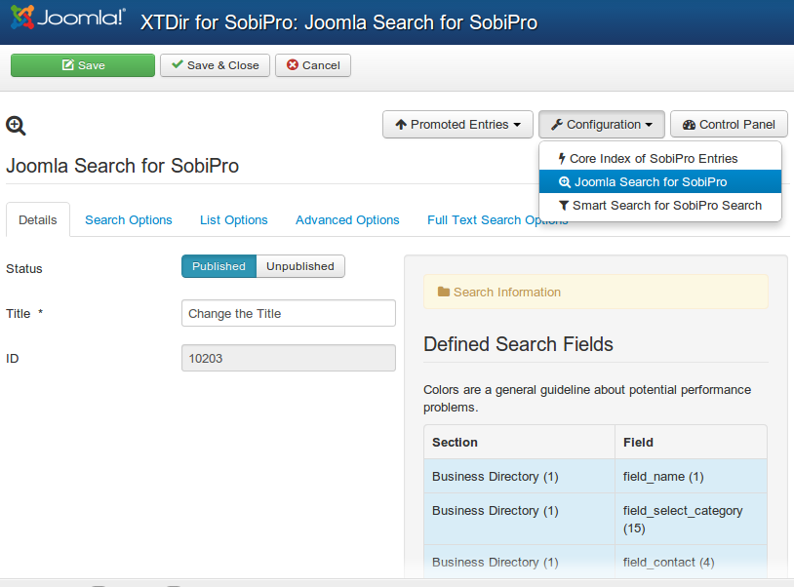
Joomla Search for SobiPro plugin
XTDir Search Plugin+ (Plus) for SobiPro is a Joomla search plugin. It extends the core Joomla search engine to support SobiPro entries.
It allows to search with the same search fields defined in SobiPro.
Please, check each tab for further configuration.

Slide 47
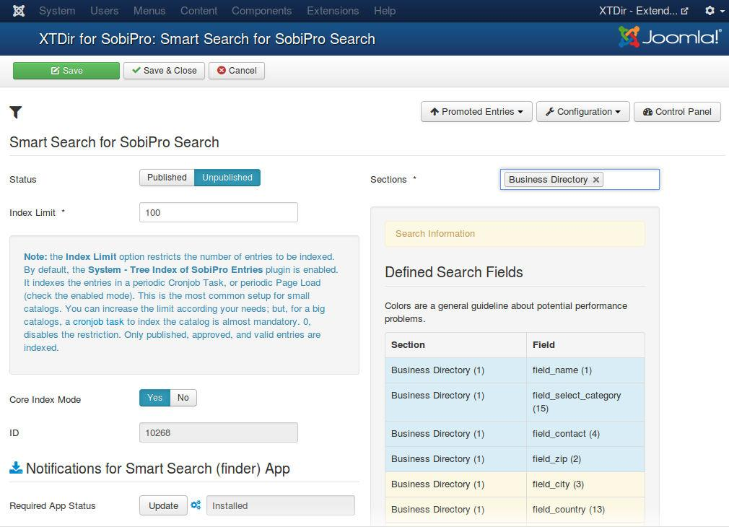
Smart Search for SobiPro plugin
XTDir Smart Reach for SobiPro plugin is a solution to integrate SobiPro with the new Joomla 2.5/3.0 full text (smart) search technology.
The Index Limit can be extended to any number, according your server processing.
The Cronjob Mode is also available.
It allows to search with the same search fields defined in SobiPro.
Notifications for Smart Search App, it's required to process incremental updated to the Finder Index. Please, click in the install button, and visit each Section to enable it.
php -f cli/finder_indexer.php

Slide 48
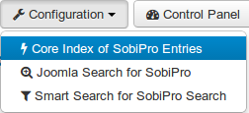
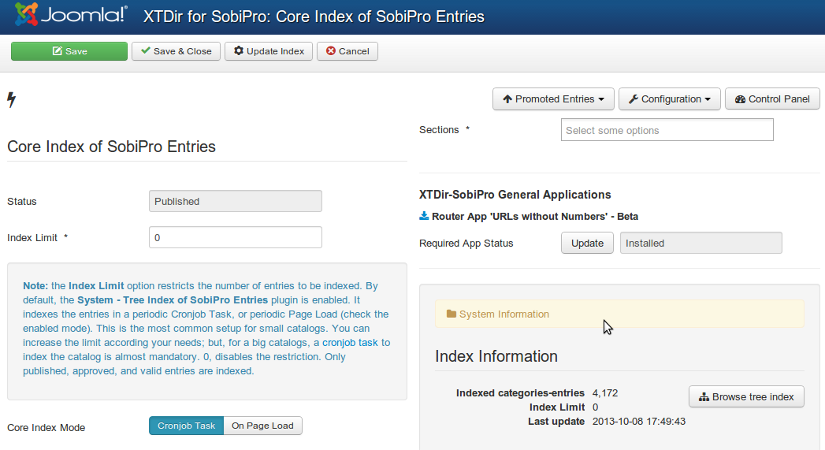
Core Index - Manual & Cronjob
Core Index of SobiPro Entries - Configuration
The Index Limit can be extended to any number, according to your server processing.
By default, you can manually index the entries.
Also, the Cronjob Mode is enabled.
To run the cron job task CLI:
Or, to run the Web cron job task (XTDir v5.4.1, or superior):
To enable the web cron job a password must be entered. Reference: User Manual - Automating Indexing
php -f cli/xtdir_indexer.php
wget -O /dev/null "http://your-domain.com/index.php?option=com_xtdir&view=cron&task=run&key=Secret" > /dev/null

Slide 49
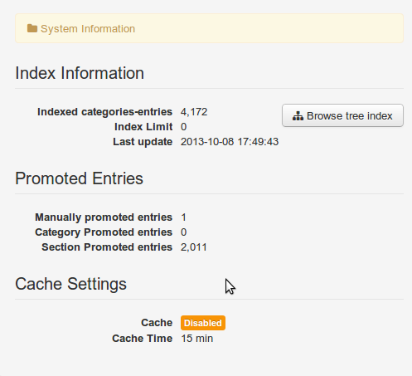
Core Index - On Page Load Mode
Core Index of SobiPro Entries - On Page Load
If the Cronjob mode is disabled, the extension enters in Page Load mode.
The Page Load mode generates the Core Index according to your Cache settings (Joomla Global Configuration / System /Cache Settings).
E.g. Cache enabled and Cache Time 15 min, the Core Index is generated every 15min, in a page load.
NOTE: If Cache is disabled, the Core Index is generated in every Page Load.

Slide 50
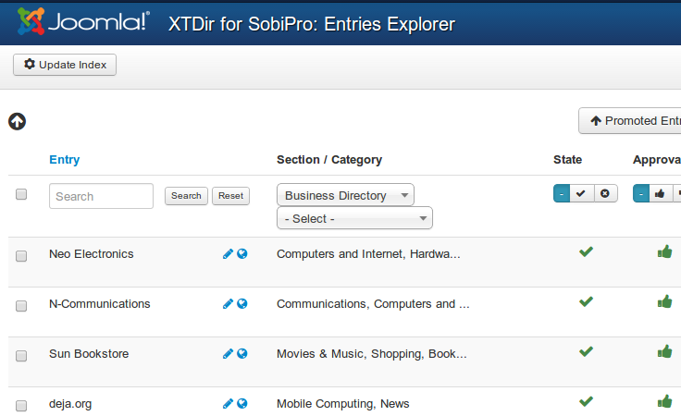
Which is the best Index Mode?
Manual Generation: It comes in handy if your catalog is small / medium size (< 1.000), static; or you are developing the site, frequently changing the parameters.

Slide 51
Which is the best Index Mode?
Cronjob Task: It's a production index generation mode for big catalogs (> 1.000). The frequency must be adjusted according your catalog size and server processing. E.g. 20 minutes.
On Page Load Index Generation: It's well suited for small catalogs (< 500). A page load is going to require more time (generating the index). E.g. 100 entries in 10 seconds. If your cache is enabled, with Cache Time 15 min, every 15 min a page load is going to require 10 seconds more.

Slide 52
One last word
We love your feedback, it's our way to improve.
This presentation was created with your help.
Please post a rating and a review at the #JED
It really helps ;-)
Support: http://support.extly.com Community Forum Support: http://www.extly.com/forum/index.html
Twitter @extly
Facebook facebook.com/extly

