Slide 1
Joocial
Recipes
social content management
http://www.extly.com/joocial-full-social-content-management-in-joomla.html
Presentation based on Joomla 3, AutoTweetNG Joocial v7.1.0 and K2 v2.6.7 2014-02-12

Slide 2
Joocial - K2 social content management
Joocial is a powerful social content platform to manage multiple social networks for Joomla. It provides Auto-Posting, a Cronjob Scheduler, Front-End Social Management, a Virtual Manager, and Publishing Tools.
In this presentation, we are going to show how you can use Joocial with K2, the powerful content extension for Joomla!.
Product Page: http://www.extly.com/autotweet-ng-pro.html
Support: http://support.extly.com Community Forum Support: http://www.extly.com/forum/index.html

Slide 3
Joocial - K2 social content management
Prerequisites
AutoTweetNG Joocial v7.1, or superior
K2 v2.6, or superior
System requirements:
- Joomla 2.5 / Joomla 3
- PHP 5.3, or superior
- MySQL 5.5, or superior (recommended)
Recommended tutorials:
Joocial - Full Social Content Management in Joomla
How to AutoTweet from Joomla in 5 minutes
How to AutoTweet from Your Own Facebook App
Improve your social streams with RSS Feeds
Publishing to Google+ Profiles and Pages

Slide 4
Joocial - K2 social content management
What’s new
Social Publishing Management New tools to create, edit, schedule, and repeat posts.
Virtual Social Media Manager High-level virtual assistant to manage when Posts are published, and evergreen posts support (re-publishing).
Jootool - Front-end Social Management Team Front-end team tool to configure channels, browse, manage content requests and posts.

Slide 5
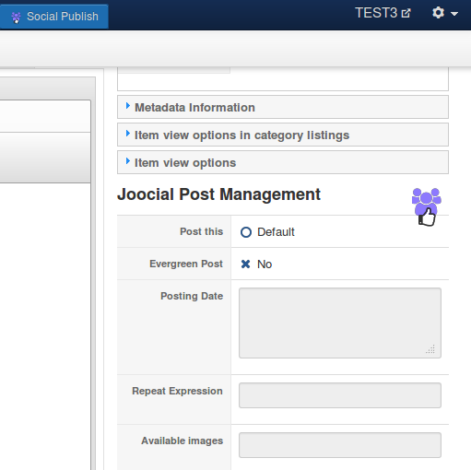
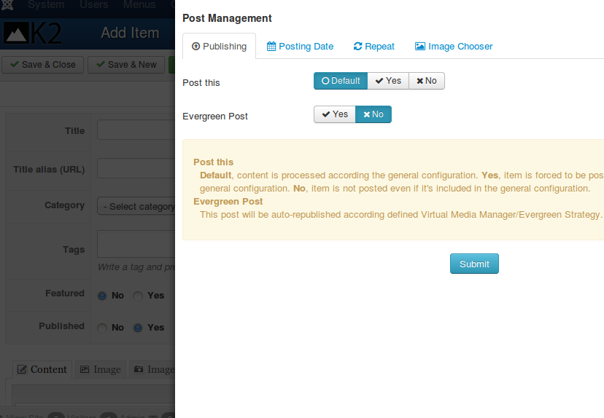
Joocial - K2 social content management
Social Publishing Management
Social Publishing Management: beyond auto-posting content, Joocial introduces tools at component item level to define specific properties.

Slide 6
Joocial - K2 social content management
Social Publishing Management
Post Management is available in the integrated components
Integrated with Joomla Articles, EasyBlog, FlexiContent, JoomShopping, K2, SobiPro, Zoo, and more.

Slide 7
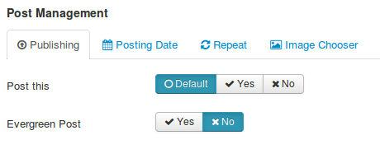
Joocial - K2 social content management
Social Publishing Management
Post This: Allows to force publishing this post (when it’s generally excluded), or do not post it (when it’s generally included)
Evergreen Post: Check it to mark the post as evergreen (virtual management can re-publish it)

Slide 8
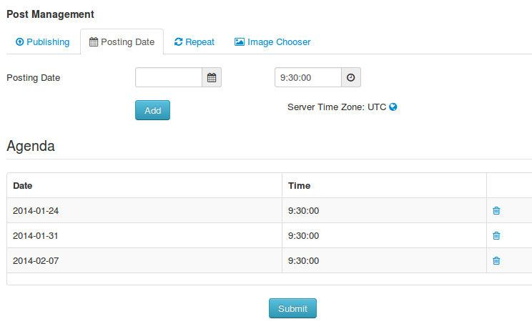
Joocial - K2 social content management
Social Publishing Management
Posting Date: Schedule when the Post must be published, and a sequence of re-publications.

Slide 9
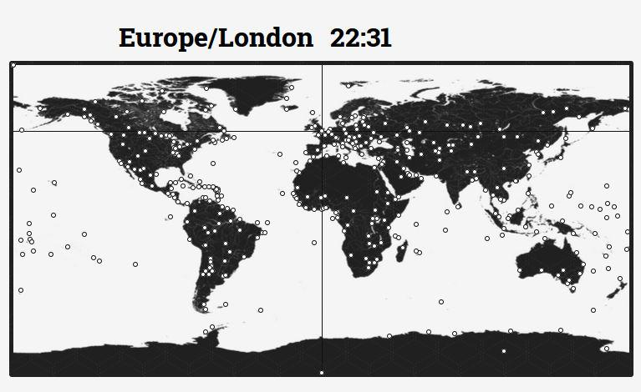
Joocial - K2 social content management
Social Publishing Management
About World Clock & Time Zone Map: all times are related to the server time zone. Please, remember to adjust it according to your audience.

Slide 10
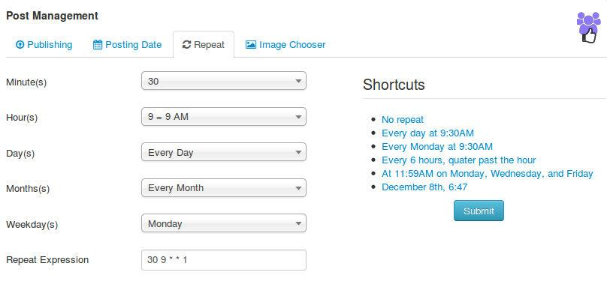
Joocial - K2 social content management
Social Publishing Management
Repeat: Define a frequency of repetitions for this post.
It can start right away, or you can define a first posting date. To stop it, you must cancel the content request.

Slide 11
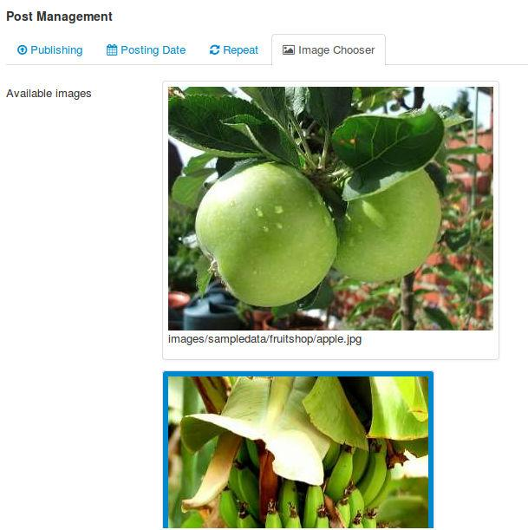
Joocial - K2 social content management
Social Publishing Management
Image Chooser: Select which article image must be included in Post.
If no image is chosen, Post is created with the first available image.

Slide 12
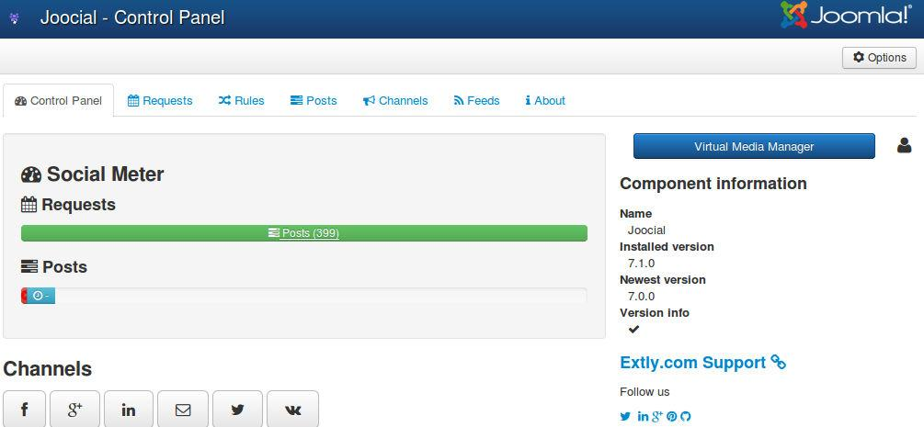
Joocial - K2 social content management
Virtual Social Media Manager
Virtual Media Manager: Provides a virtual assistant to support high level operations:
Only publish in “working hours”
If there’s nothing new to publish from site or RSS Feeds, re-publish “evergreen” content

Slide 13
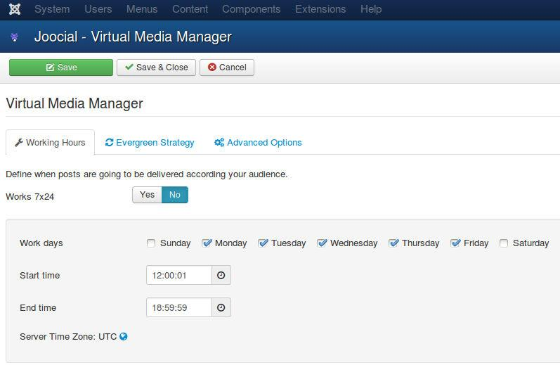
Joocial - K2 social content management
Virtual Social Media Manager
Working Hours: Define to allow Post publication at any time, or focused in a period of time.
E.g. You can receive new articles with RSS Feeds, and filter them according your audience. But if your users are more active at some hours, you can define the “working hours” to your Virtual manager.

Slide 14
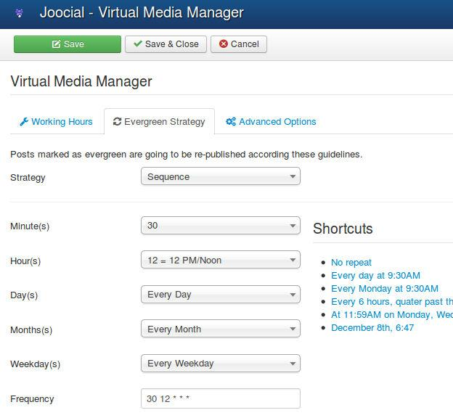
Joocial - K2 social content management
Virtual Social Media Manager
Evergreen Posts: Posts selected as evergreen can be posted if there’s no content available. In this form, you can define frequency of evergreen posts.
Strategy: It can be random or in sequence. In both cases, a great number of evergreen posts is recommended to avoid channel saturation.
Reference: Should bloggers and businesses share old content?

Slide 15
Joocial - K2 social content management
Virtual Social Media Manager
Evergreen Posts: Posts selected as evergreen can be posted if there’s no content available. In this form, you can define frequency of evergreen posts.
Strategy: It can be random or in sequence. In both cases, a great number of evergreen posts is recommended to avoid channel saturation.
Reference: Should bloggers and businesses share old content?

Slide 16
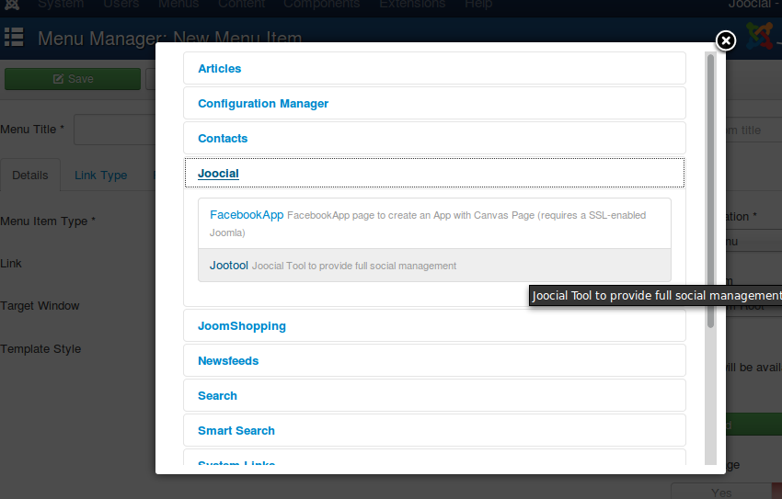
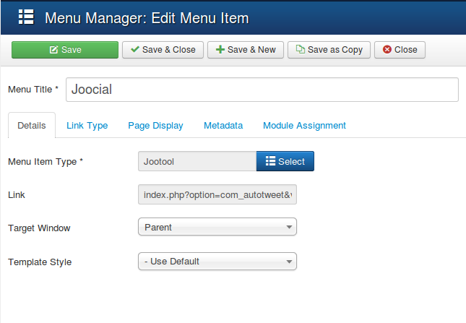
Joocial - K2 social content management
Front-end Social Management Team
Jootool: It’s a new front-end solution for your social management team.
To start, please create a new Menu Item for Joocial

Slide 17
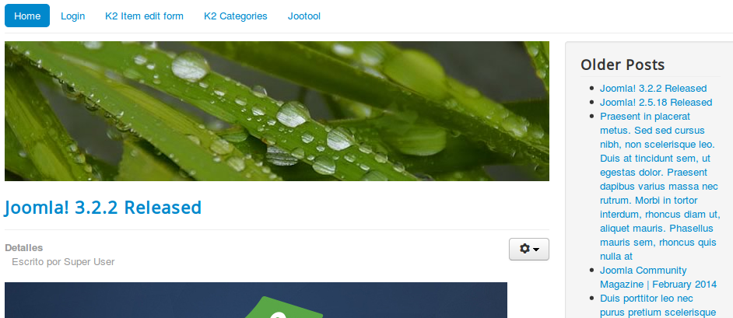
Joocial - K2 social content management
Front-end Social Management Team
Jootool: It’s a new front-end solution for your social management team.

Slide 18
Joocial - K2 social content management
Front-end Social Management Team
In Joomla!, you can have several User Groups (*).
By default, Jootool allows these operations:
User | Create | Edit Own | Edit | Edit State | Delete | Access Backend | Configuration
Author | ok | ok
Editor | ok | ok | ok
Publisher | ok | ok | ok | ok
Manager | ok | ok | ok | ok | ok
Administrator | ok | ok | ok | ok | ok | ok
Super User | ok | ok | ok | ok | ok | ok | ok
In K2, Administrator has to allow users to submit content:
Allowing users to submit content
(*) For further information: http://docs.joomla.org/ACL
Permissions can be customized by Administrator in Global Configuration

Slide 19
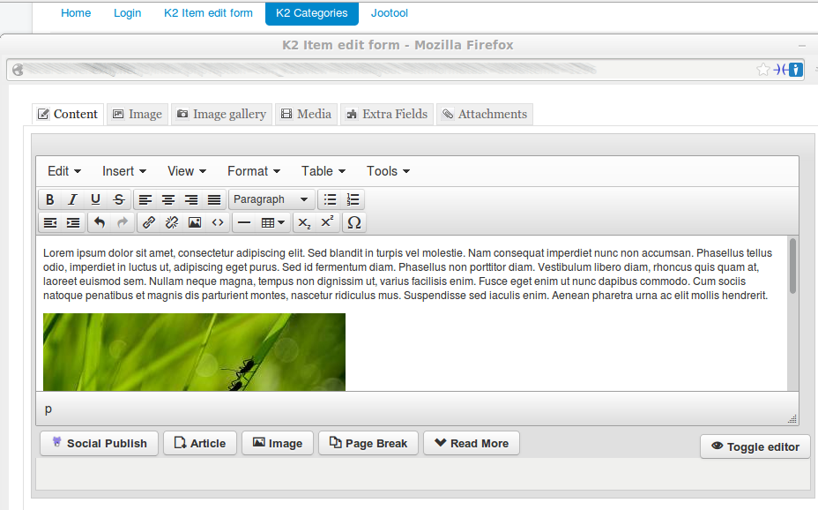
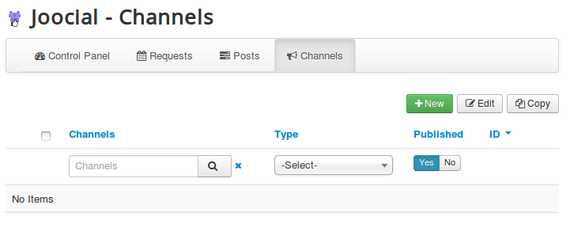
Joocial - K2 social content management
Front-end Social Management Team
Author:
Create content and Edit Own “Social Publishing” Options
Create and Edit own channels.

Slide 20
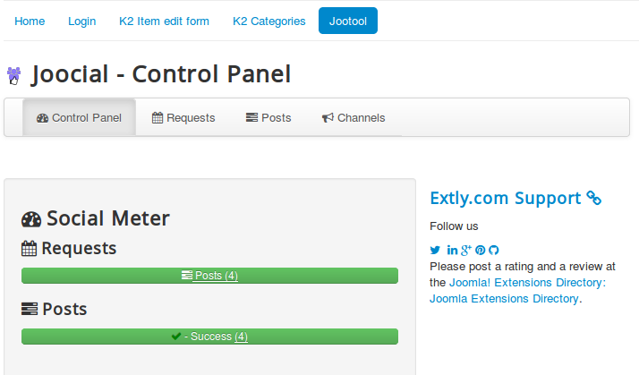
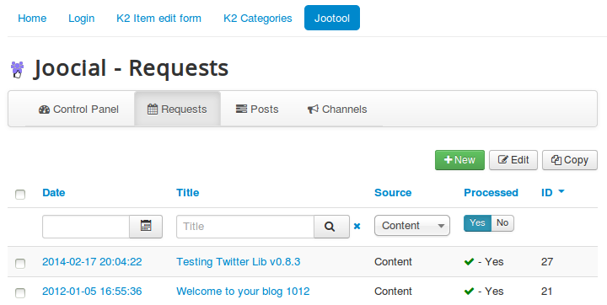
Joocial - K2 social content management
Front-end Social Management Team
Editor:
Create and Edit content, Edit “Social Publishing” Options
Create and Edit channels.
Requests and Posts: Check Status

Slide 21
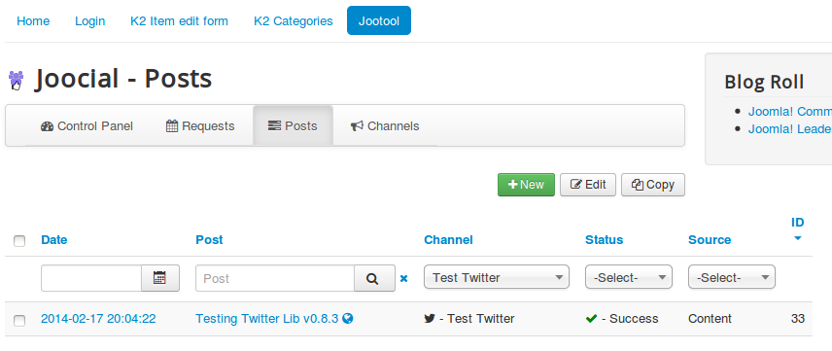
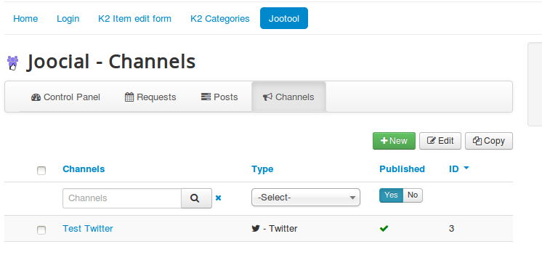
Joocial - K2 social content management
Front-end Social Management Team
Editor:

Slide 22
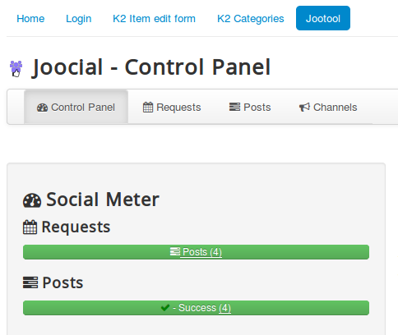
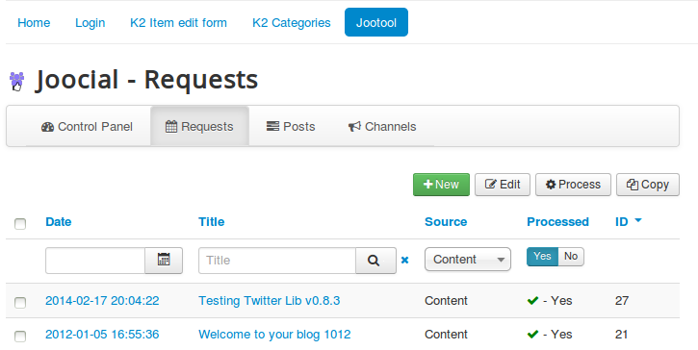
Joocial - K2 social content management
Front-end Social Management Team
Publishers:
Create, Edit and Edit State content, Edit “Social Publishing” Options
Create, Edit and Publish channels.
Requests and Posts: Check Status, Process and Publish

Slide 23
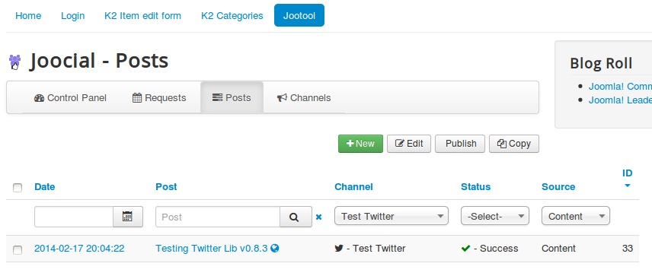
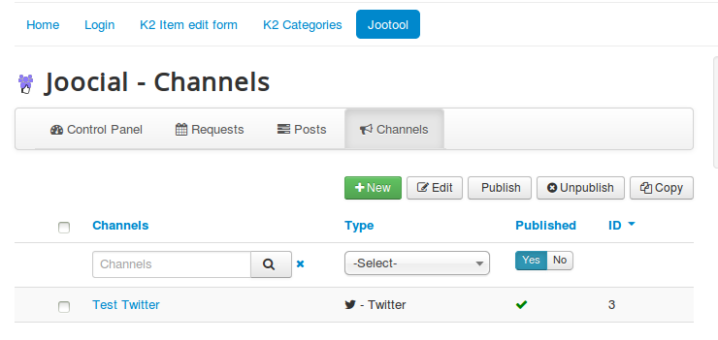
Joocial - K2 social content management
Front-end Social Management Team
Publishers:

Slide 24
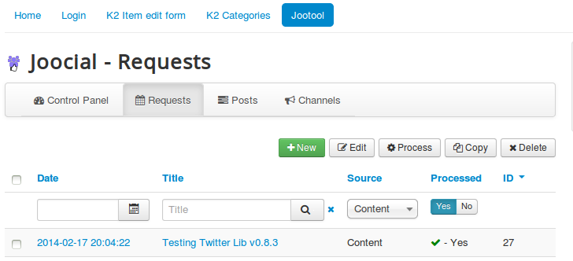
Joocial - K2 social content management
Front-end Social Management Team
Managers:
Create, Edit and Edit State content, Edit “Social Publishing” Options
Create, Edit, Publish and Delete channels.
Requests and Posts: Check Status, Process, Publish and Delete

Slide 25
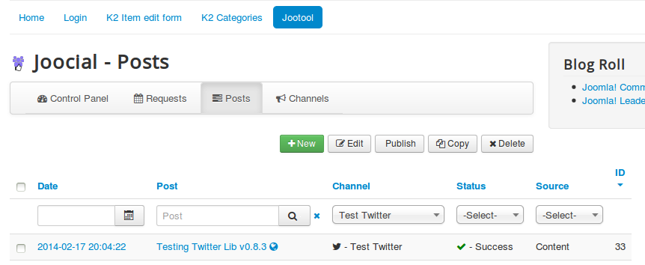
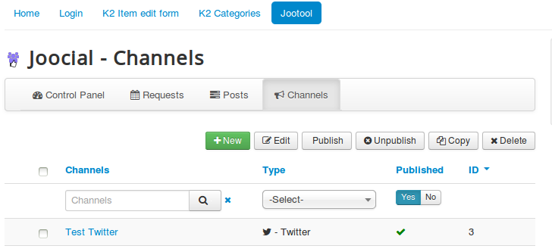
Joocial - K2 social content management
Front-end Social Management Team
Managers:

Slide 26
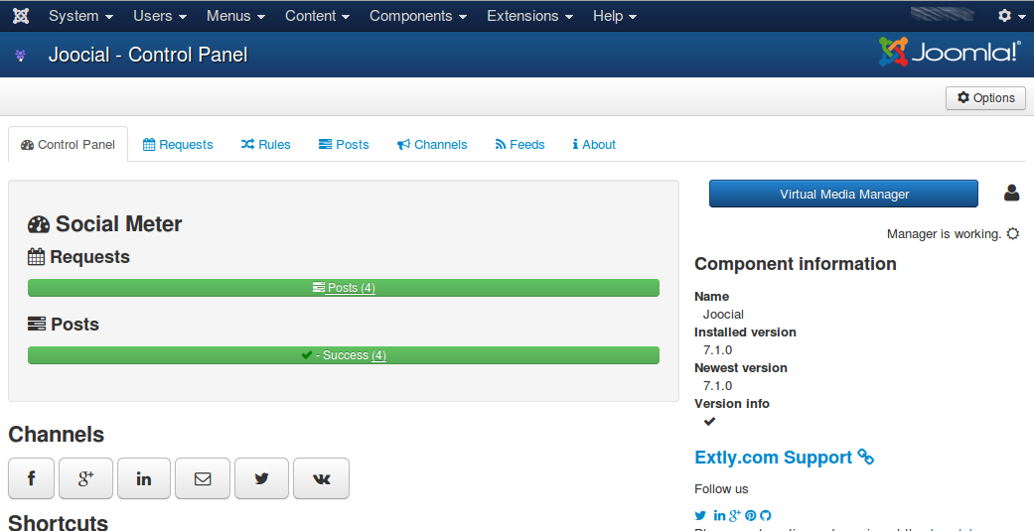
Joocial - K2 social content management
Front-end Social Management Team
Administrators and Super Users:
Create, Edit and Edit State content, Edit “Social Publishing” Options
Create, Edit, Publish and Delete channels.
Requests and Posts: Check Status, Process, Publish and Delete
Access Administration Interface, Feeds and Virtual Media Manager

Slide 27
Joocial - K2 social content management
Conclusion
In this presentation, we have shown the new features available in Joomla for full social content management:
Social Publishing Management: New tools to create, edit, schedule, and repeat posts.
Virtual Social Media Manager: High-level virtual assistant to manage when Posts are published, and evergreen posts support (re-publishing).
Jootool - Front-end Social Management Team: Front-end team tool to configure channels, browse, manage content requests and posts.

Slide 28
One last word
We love your feedback, it's our way to improve.
This presentation was created with your help.
Please post a rating and a review at the #JED
It really helps ;-)
Support: http://support.extly.com Community Forum Support: http://www.extly.com/forum/index.html
Twitter @extly
Facebook facebook.com/extly

